Slide 1
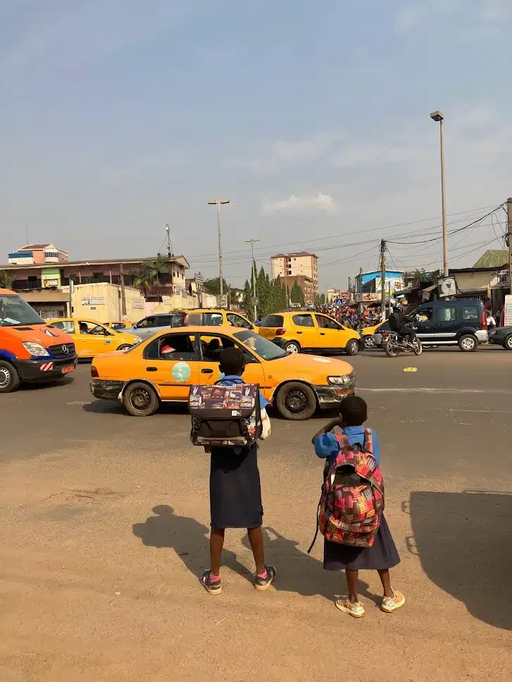
MobiliseYourCity Support to Yaoundé on Urban Mobility
From SUMP to MoVe Yaoundé

Slide 2
Agenda
Introduction to MobiliseYourCity
01
Yaoundé SUMP Development
02
Q&A and Discussion
03

Slide 3
01
Introduction to MobiliseYourCity

Slide 4






MobiliseYourCity
A European-led global partnership helping cities and countries move from sustainable urban mobility planning to concrete investment and action.
82
16
172m
member cities
member countries
people represented
MobiliseYourCity bridges the gap between planning and investment by adapting the European SUMP methodology to developing and emerging economies.
75
€120m+
Projects across 38 countries
Grants from the EU, France and Germany
Donors:

Slide 5
In 2026
The MobiliseYourCity Partnership
accounts for
82 Member Cities
and 16 Member Countries

Slide 6
MobiliseYourCity supports member cities and countries through four service areas
Adapting SUMPs to developing cities to reduce emissions
From plans...
Mobility Planning
Supporting inclusive,
low-carbon transport planning and investment readiness.
Capacity Building
Equipping practitioners with tested, scalable mobility solutions.
SUMPs and NUMPs identify priority measures, costs, governance needs and investment pipelines.
...to projects...
Implementation support de-risks pilots, project preparation, paratransit reform, active mobility and institutional strengthening.
Implementation Support
Bridging planning and implementation for green and just cities.
Advocacy & Outreach
Promoting sustainable mobility through partnerships, communication, and engagement.
...to systems change
Capacity building and advocacy spread tested methodologies and build political support for sustainable mobility.

Slide 7
02
Yaoundé SUMP Development
Support provided
Results and impacts
Lessons learned

Slide 8

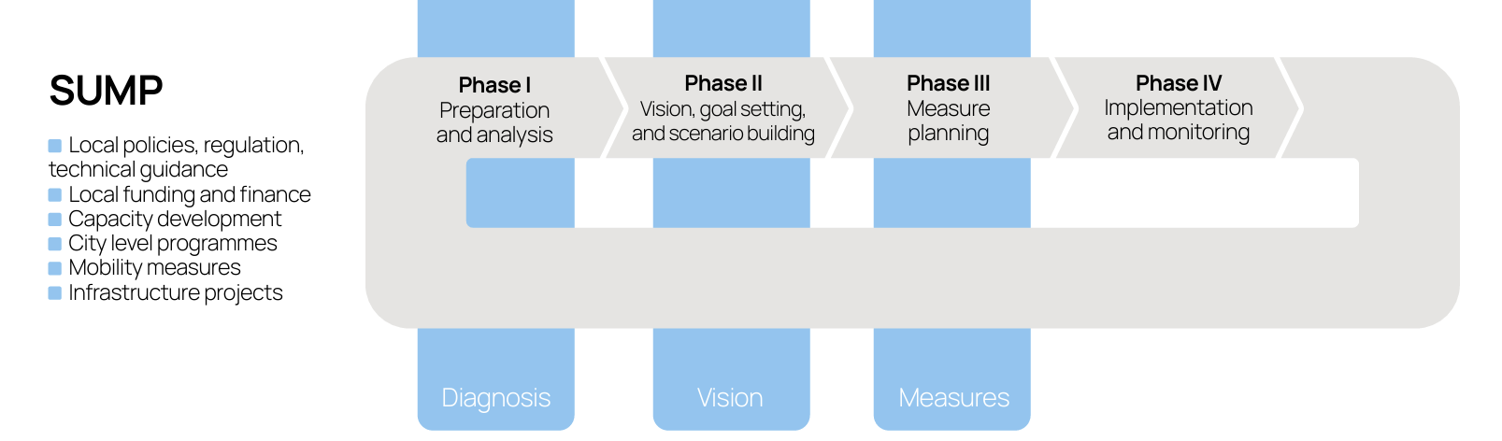
Yaoundé SUMP Development Timeline
Q2 2016 | Q4 2016 | Q2 2018 |  | Q3 2019
MobiliseDays | Joined MobiliseYourCity | SUMP Development Begins |  | SUMP Finalised
Initial engagement with the Partnership and exchange of experiences with peer cities. | Yaoundé became an official member of the MobiliseYourCity Partnership. | Technical studies, stakeholder consultations and mobility diagnostics were launched. |  | The Sustainable Urban Mobility Plan was completed, establishing a roadmap for future investments.
Source: MobiliseYourCity Global Monitor 2026

Slide 9
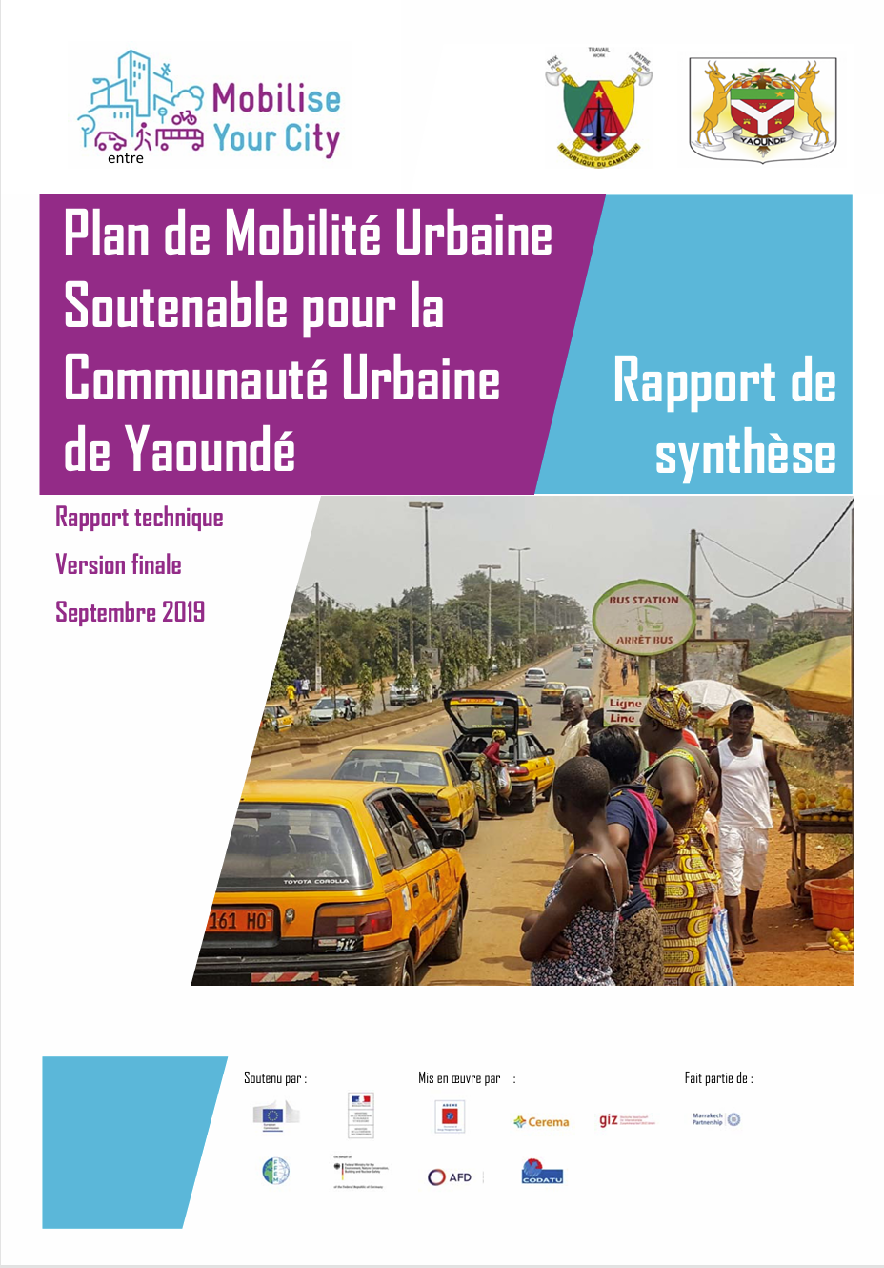
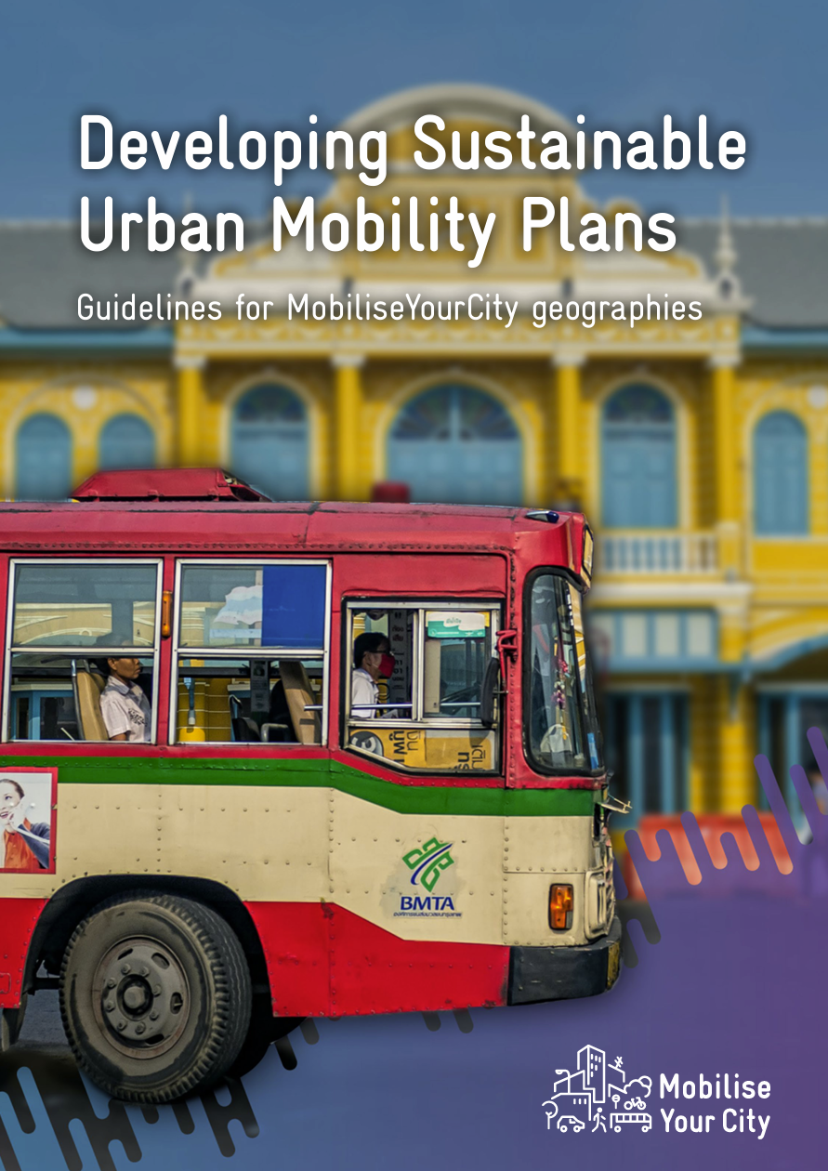
One of the very first MobiliseYourCity supported SUMPs
2019
2023

Slide 10
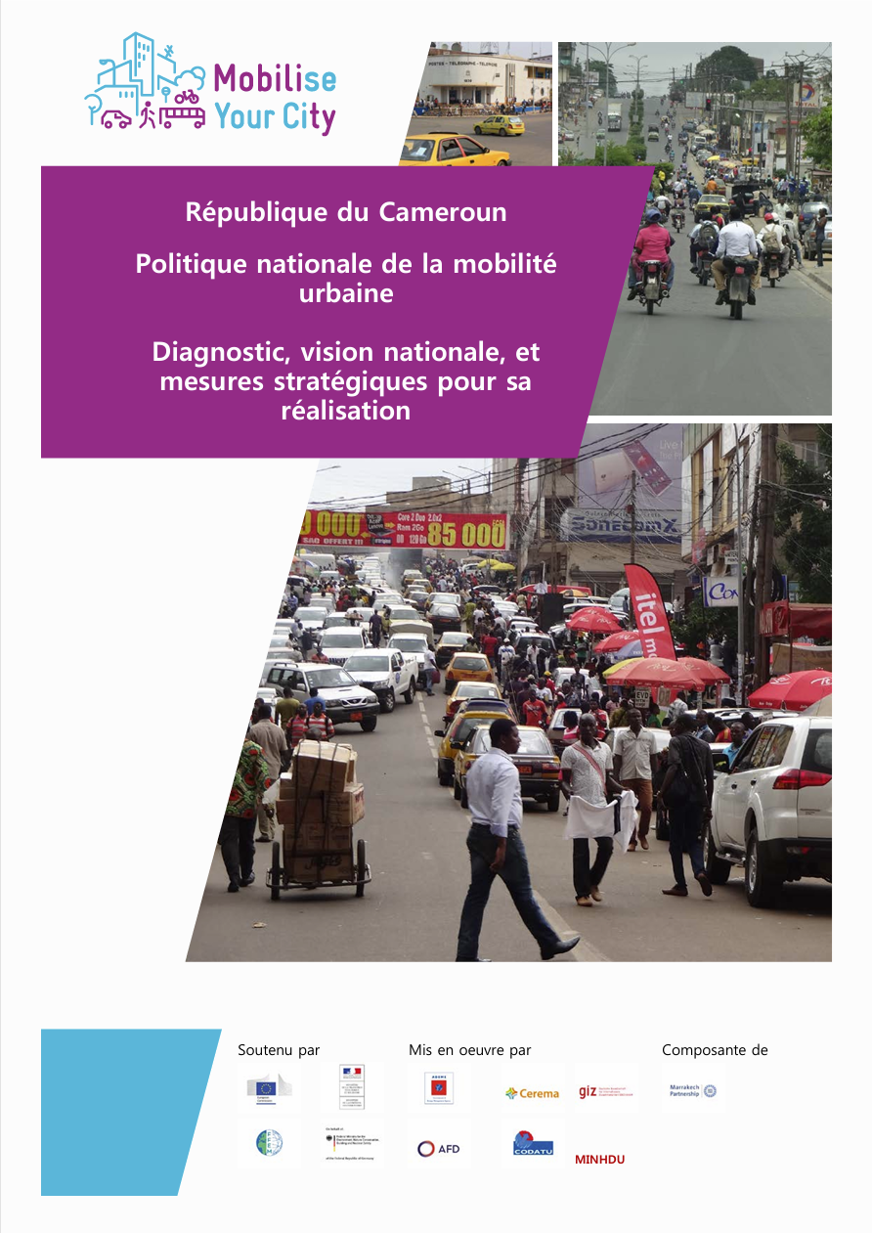
Yaoundé’s SUMP was developed in parallel with Cameroonian National Urban Mobility Policy (NUMP)
The simultaneous development of the National Urban Mobility Plan (NUMP) and the city-level SUMP has provided Yaoundé with a clear, coherent, and action-oriented strategic framework. This dual-level planning has helped align priorities and strengthened the legitimacy of interventions.

Slide 11
Yaoundé SUMP has a climate mitigation focus
Projected increase in annual GHG emissions by 2029 (vs. BAU):
• Business-as-usual scenario: +101%
• SUMP scenario: +59%
SUMP Scenario chosen: Central scenario
This scenario provides immediate solutions to road network issues. It is an ambitious infrastructure project focused on increasing road capacity to accommodate rising private vehicle traffic with a significant shift to public transport.

Slide 12
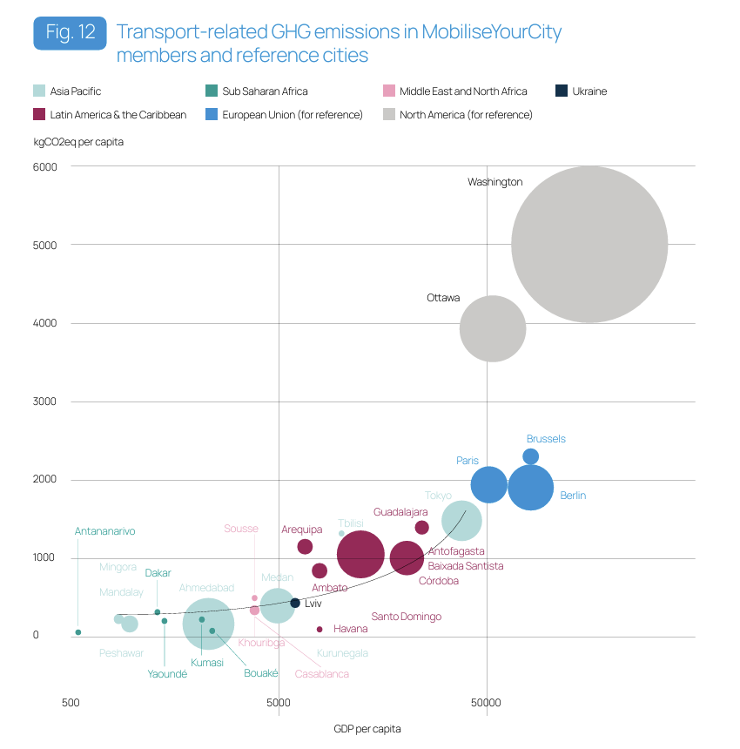
Transport-related GHG emissions in MobiliseYourCity and reference cities
Yaoundé has the potential to decouple economic development from GHG emissions

Slide 13
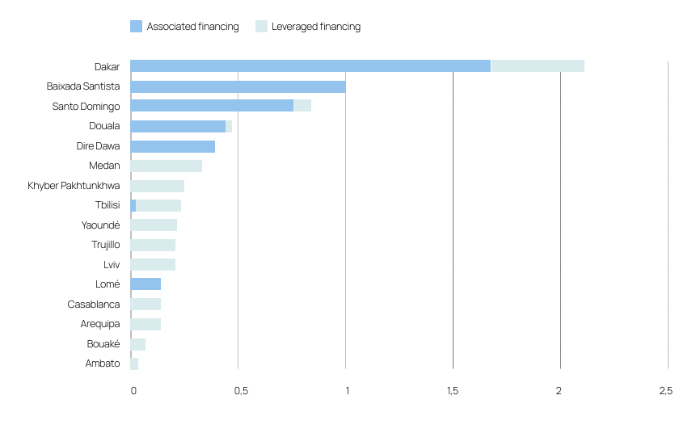
Associated and leveraged finance for MobiliseYourCity cities that adopted a SUMP (in billion EUR)
The Yaoundé SUMP has helped mobilise approximately EUR 469 million in secured and planned financing for sustainable urban mobility projects.
Funding has supported road and public transport improvements, active mobility infrastructure, institutional reforms, and capacity building.

Slide 14

Identified investment needs for urban mobility
Investment Requirements – CAPEX | • By 2025: EUR 298.1 million • By 2030: EUR 550.0 million • By 2035: EUR 554.7 million
Investment Requirements – OPEX | • By 2030: EUR 151.0 million • Yearly OPEX to 2035: EUR 770.0 million
Total CAPEX & OPEX (by 2030) | EUR 701.0 million

Slide 15
Key Lessons Learned from Yaoundé SUMP
1. Strengthen Local Ownership
Local mobility authorities should lead the SUMP process.
Clearly define responsibilities and build monitoring capacity.
2. Use Context-Appropriate Data Collection
Large household travel surveys can be costly and not always needed.
Combine existing demographic data with targeted origin-destination surveys and fieldwork.
3. Apply Traffic Models Selectively
Complex predictive models are expensive and may be difficult for local stakeholders to use.
Prioritize local expertise and observations; use models mainly for later-stage studies.
4. Better Integrate Transport and Urban Planning
Align mobility planning with urban development plans.
Strengthen institutions, governance, and implementation capacity.

Slide 16
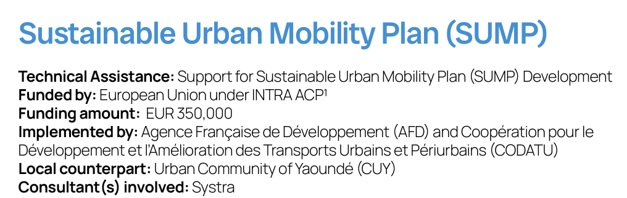
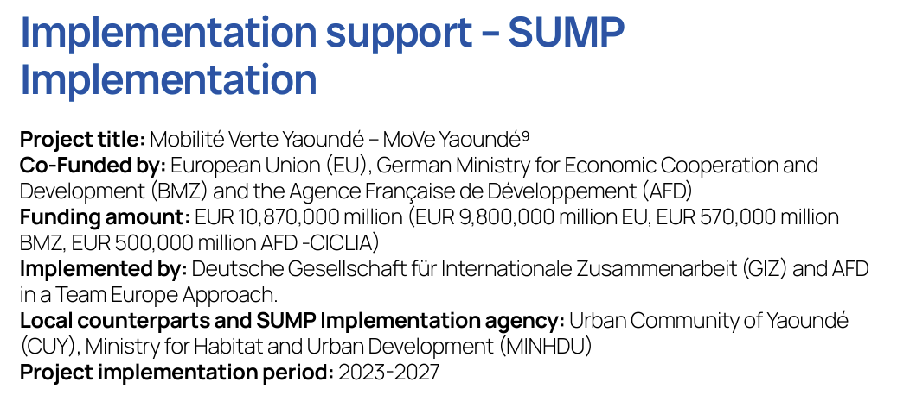
Yaoundé, Cameroon
Support from the Partnership

Slide 17
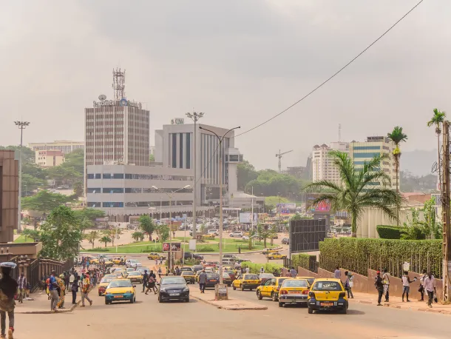
contact@mobiliseyourcity.net
jacopo.giavoli@mobiliseyourcity.net

