Slide 1
The MobiliseYourCity Partnership
An introduction
October 2024

Slide 2
2
The Partnership
Sustainable urban mobility planning
3
4
The MobiliseYourCity Partnership’s recent achievements
Final remarks

Slide 3
1
The Partnership

Slide 4
An impactful partnership between the EU, France and Germany, established at COP21
Donors:
Implementing Partners:
Knowledge and Network Partners:
In collaboration with:

Slide 5
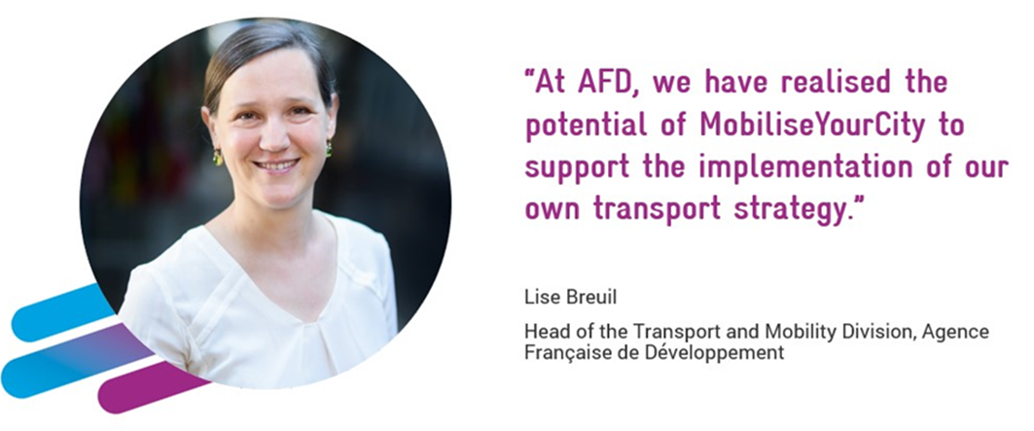
MobiliseYourCity’s guiding principles
1
2
Our vision
We work together as partners to shape low-carbon mobility systems that contribute to efficient, safe, and just cities for all urban residents of today and the future.
Our mission
Our mission is to incubate solutions, accelerate the adoption of proven approaches, and facilitate complex change processes to transform urban mobility

Slide 6
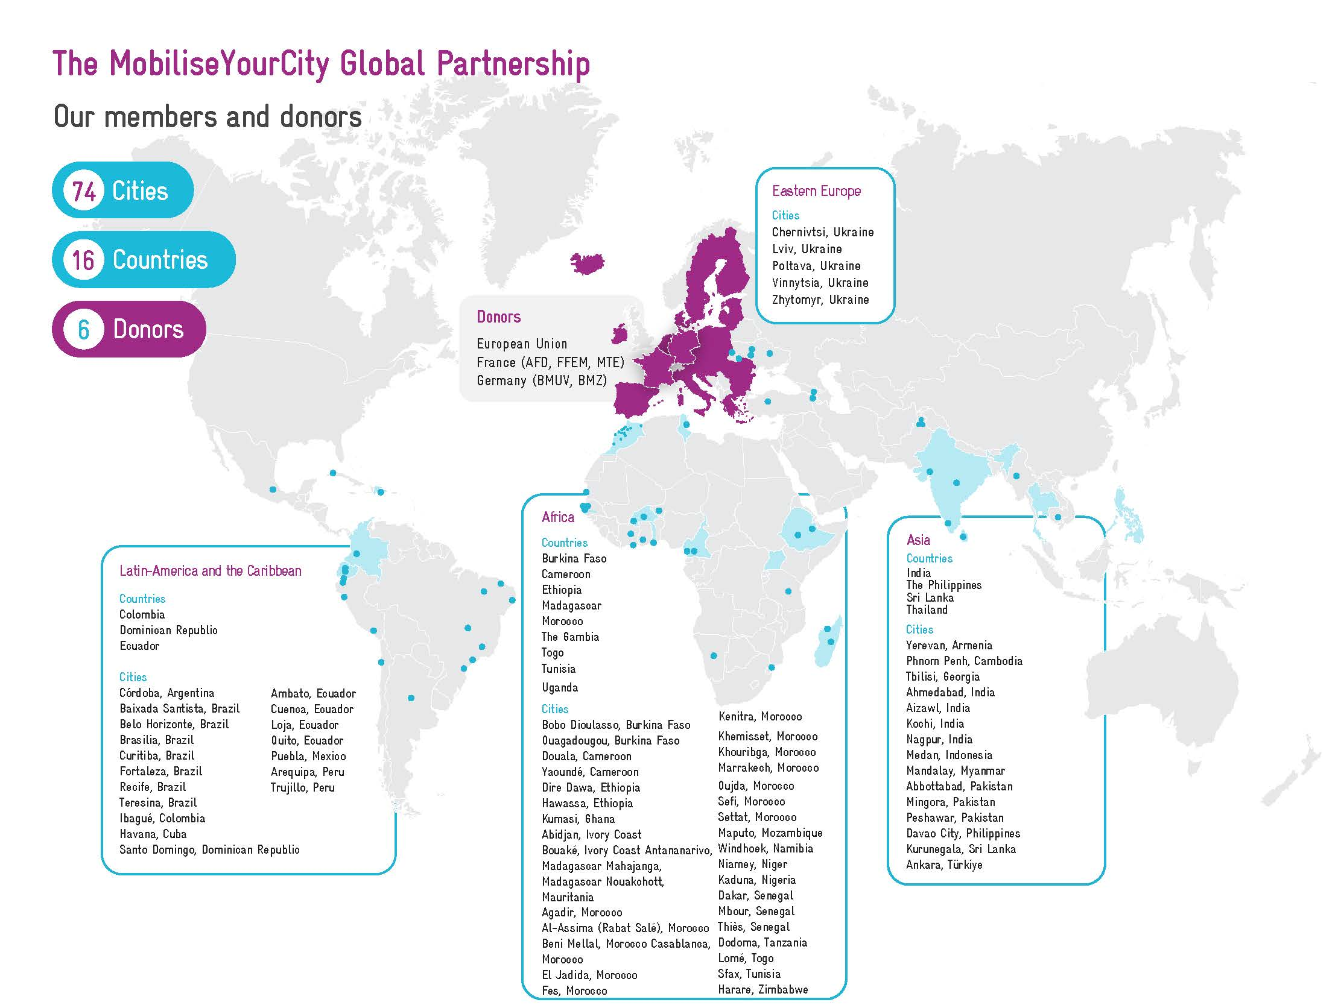
Notes:
Data from 2024 Q3

Slide 7
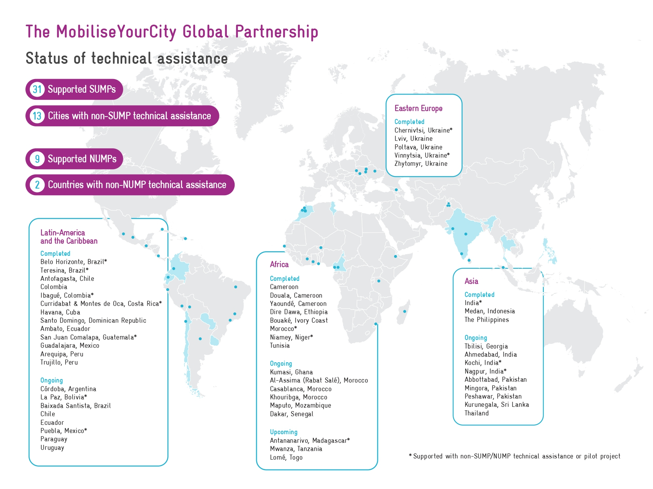
Notes:
Data from 2024 Q1

Slide 8
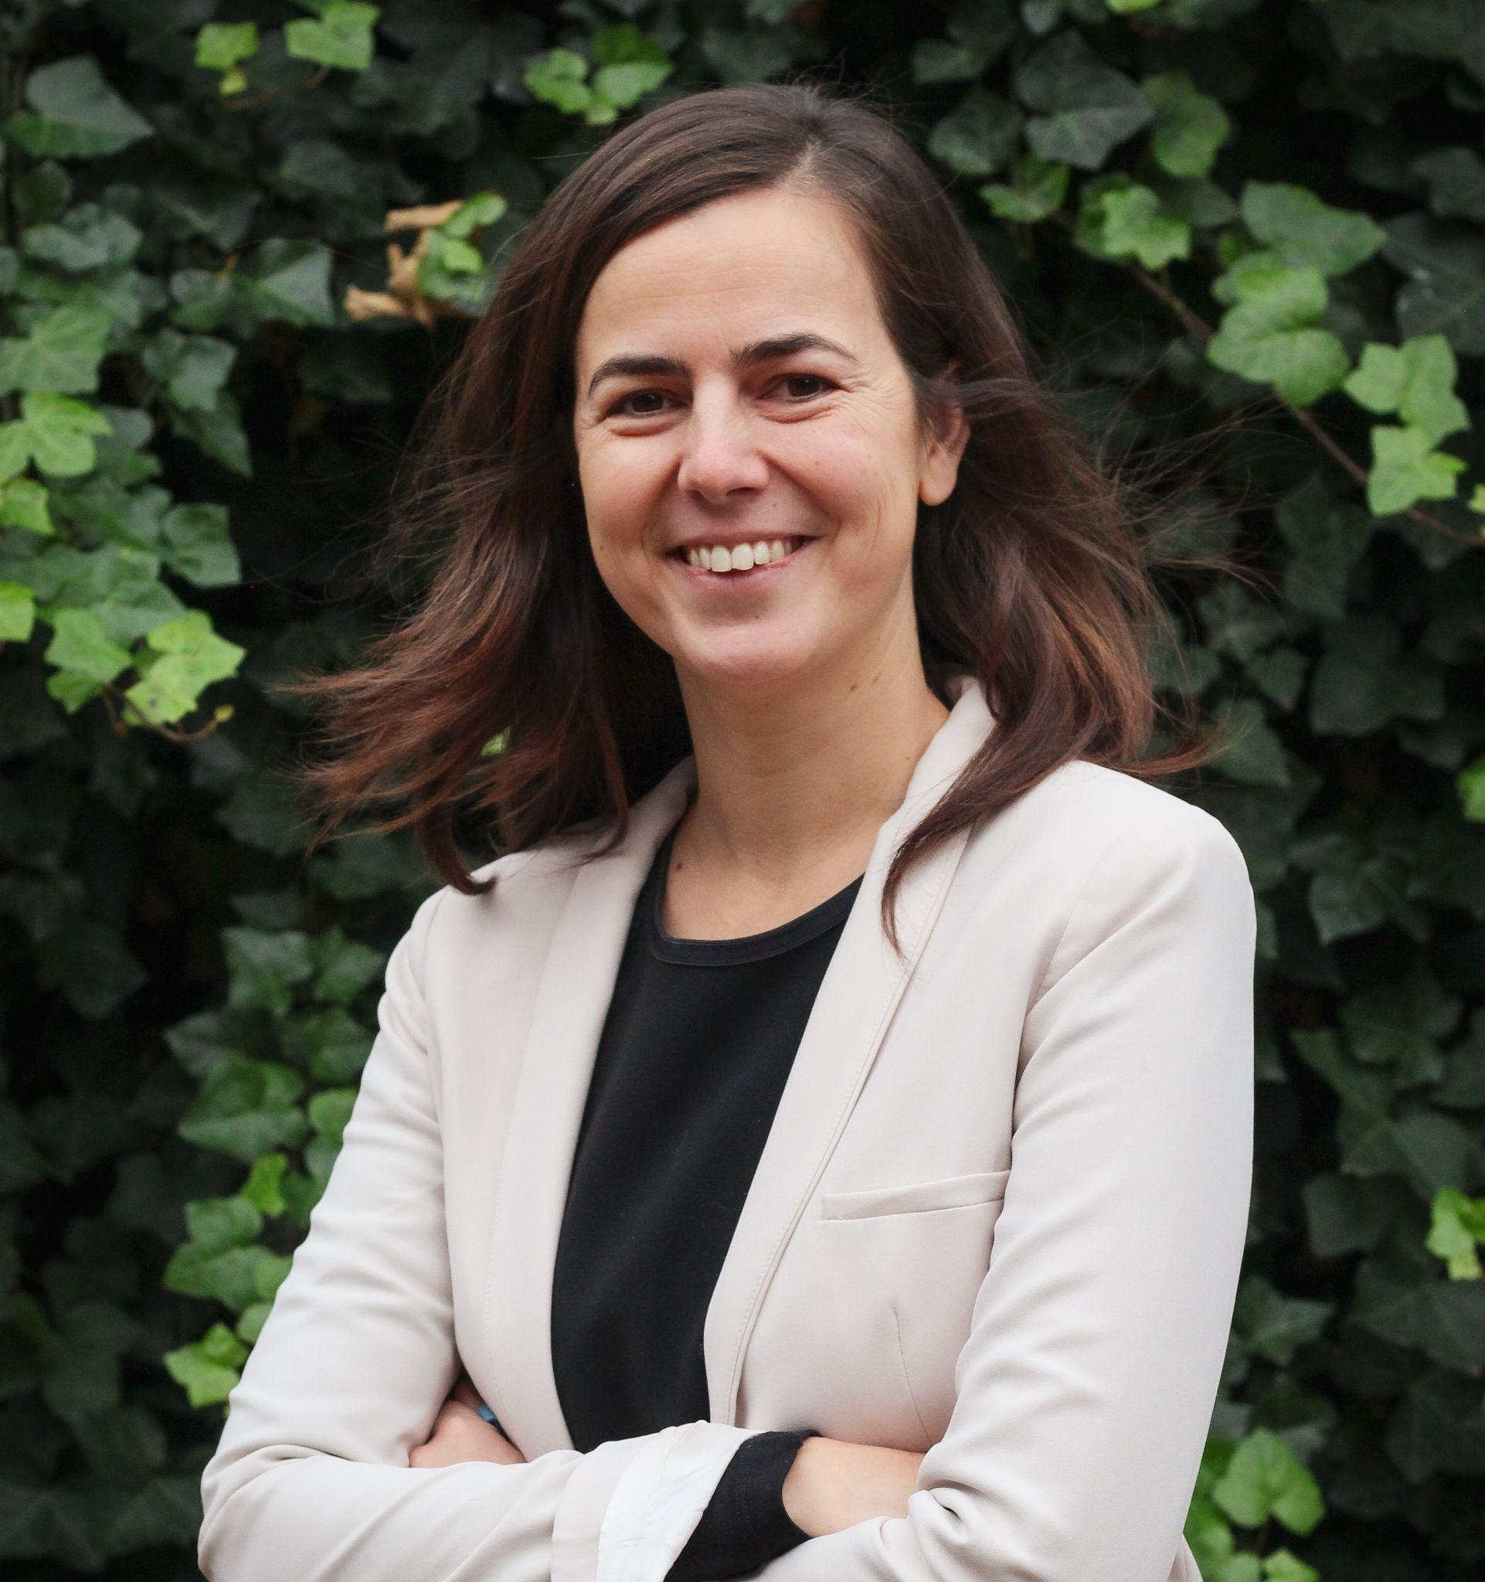
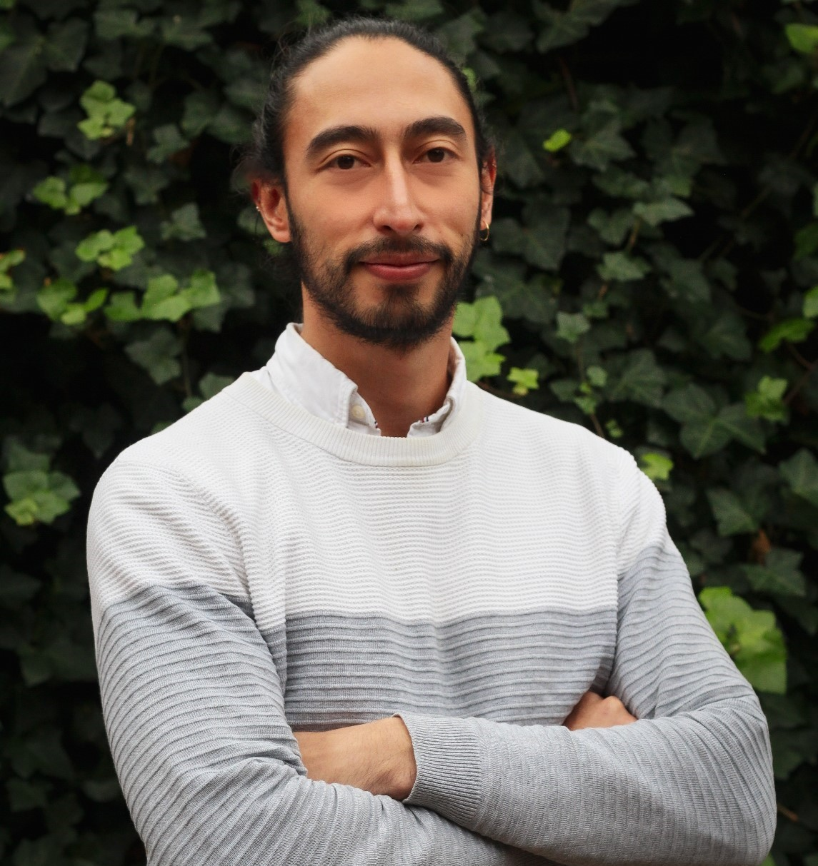
The Global Secretariat
Funded by
Sasank Vemuri
Coordinator
BMZ financed
Eléonore François-Jacobs
Deputy Coordinator-Advocacy & Outreach Manager
AFD financed
Giuliana Ambrosino
Communications Officer
AFD financed
Mobility Expert
BMZ financed
Recruitment ongoing
Nicolas Cruz González
Mobility Expert
AFD financed
Zofia Bochinska
Junior Project officer
AFD financed
Alexandra Heitplatz
Capacity Building Intern
BMZ financed
Milnael Gómez
Climate Adaptation Expert
ADEME financed
Capacity building intern
AFD financed
Recruitment ongoing

Slide 9
MobiliseYourCity’s service areas
1
2
3
4
MOBILITY PLANNING
Supporting implementation and investment ready plans for inclusive and low-carbon transport
CAPACITY BUILDING
Equipping practitioners with tested and scalable solutions
ADVOCACY
Encouraging institutions and individuals to embrace and resource sustainable mobility
IMPLEMENTATION SUPPORT
Empowering members to bridge planning with implementation for green and just cities
Supporting member cities in preparing city-level sustainable mobility plans and project preparation
Supporting member countries in preparing country-level urban mobility policies and investment programs
Deploying digital technology to improve mobility planning
Developing tailored methodologies and tools for our focus areas
Scaling our training offer to mobility professionals through strategic partnerships
Enhancing our digital platform for trainings, exchange and knowledge dissemination
Communicating local results to influence the global agenda
Engaging new partners and members to animate ambitious action
Empowering local behavioural change through evidence-based messaging
Piloting small-scale innovative finance to support walking and cycling
Professionalizing and formalizing jobs in the paratransit sector, in particular by building on digital technologies
Supporting institutional and regulatory reforms to enable implementation

Slide 10
2
Sustainable Urban Mobility Planning

Slide 11
Traditional Transport Planning |  | Sustainable Urban Mobility Planning (SUMP)
Focus on traffic | → | Focus on people
Primary objectives: traffic flow capacity and speed | → | Primary objectives: Accessibility and quality of life, including social equity, health and environmental quality, and economic viability
Mode-focussed | → | Integrated development of all transport modes and shift towards sustainable mobility
Infrastructure as the main topic | → | Combination of infrastructure, market, regulation, information and promotion
Sectoral planning document | → | Planning document consistent with related policy areas
Short and medium-term delivery plan | → | Short and medium-term delivery plan embedded in a long-term vision and strategy
Covering an administrative area | → | Covering a functional urban area based on travel-to-work flows
Domain of traffic engineers | → | Interdisciplinary planning teams
Planning by experts | → | Planning with the involvement of stakeholders and citizens using a transparent and participatory approach
Limited impact assessment | → | Systemic evaluation of impacts to facilitate learning and improvement
SUMP concept and comparison with the traditional approach
Notes:
Source: https://www.researchgate.net/figure/Differences-between-traditional-transport-planning-and-Sustainable-Urban-Mobility_fig4_357531605

Slide 12
What is a
Sustainable Urban Mobility Plan?
(SUMP)
A SUMP is a strategic plan developed with a sustainable urban mobility approach.
It aims to meet people's and businesses' mobility needs in cities and to harmonise and integrate existing planning.
The MobiliseYourCity Partnership develops SUMP in the Global South, thanks to donors and implementing Partners. The Secretariat intervenes in the implementation phase:
Notes:
https://www.mobiliseyourcity.net/developing-sustainable-urban-mobility-plans-guidelines-mobiliseyourcity-geographies

Slide 13
3
The MobiliseYourCity Partnership’s recent achievements

Slide 14
i

Slide 15
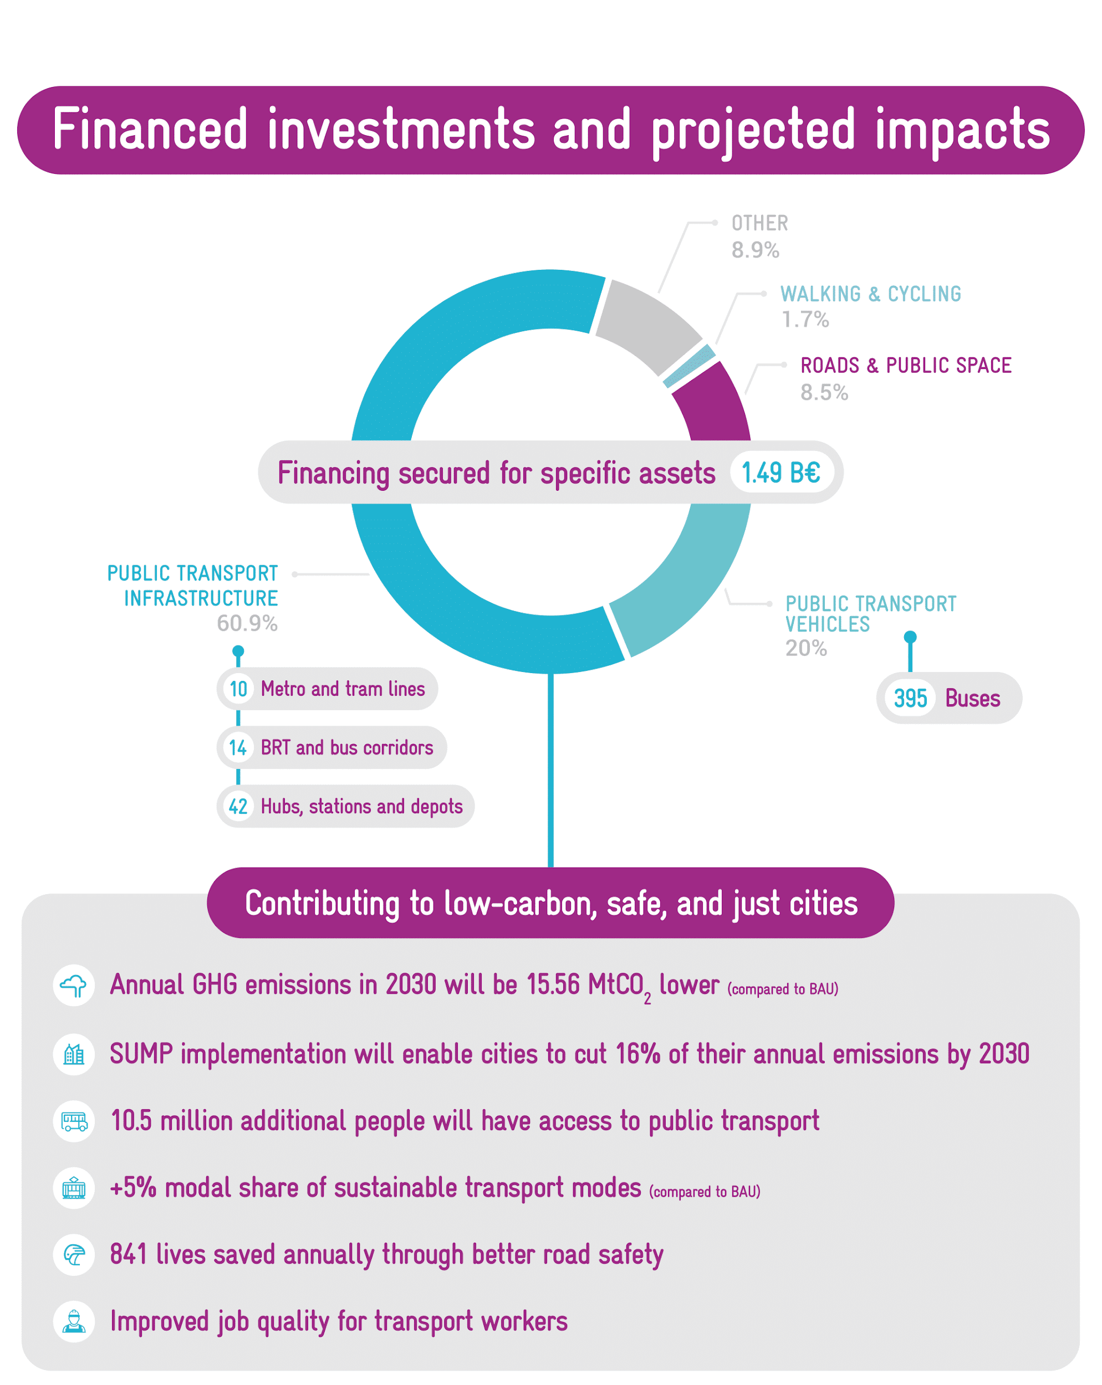
i

Slide 16
MobiliseYourCity tackles sustainable mobility through several angles
We are constantly evolving our methodological offer to better respond to the needs of our projects on the ground
The comprehensive methodology includes a range from national policy support (NUMP Guidelines) to post-SUMPs implementation, e.g. such as paratransit toolkit
Our capacity building service has been tailored for a Global Community of Practice by leveraging on the expertise generated through our local projects
Delivered 20 trainings this year, preparing as many raining modules as possible for our implementing organizations
We enable knowledge dissemination by offering a space to share valuable resources and insights from practice
Our Knowledge Platform contains more than 370 knowledge products generated by the Partnership and its partner organizations and three regional communities of practice
We have secured a firm footing in the international transport community and climate regime
Since its inception during COP21, MobiliseYourCity’s advocacy efforts towards greater investment for urban mobility at all COPs and other high-level international events, such as UN’s Sustainable Transport Conference and the Transport and Climate Change Week. We facilitate dialogue and encourage coordination among donors, implementing partners and member countries and cities
After 6 years of working together, we have developed strong ties based on trust, thus enabling coordination and alignment of efforts to transform urban mobility through sustainable urban, helping to identify new ways to keep supporting our member cities and countries beyond the planning phase.

Slide 17
4
Final remarks

Slide 18
How to apply?
Contact the MobiliseYourCity Secretariat
Fill in the application form
Sign the MobiliseYourCity Declaration stating our members’ ambition for mobility
Send the filled-in documents to contact@mobiliseyourciy.net
Wait for approval from the Steering Committee
Become a member of the Partnership

Slide 19
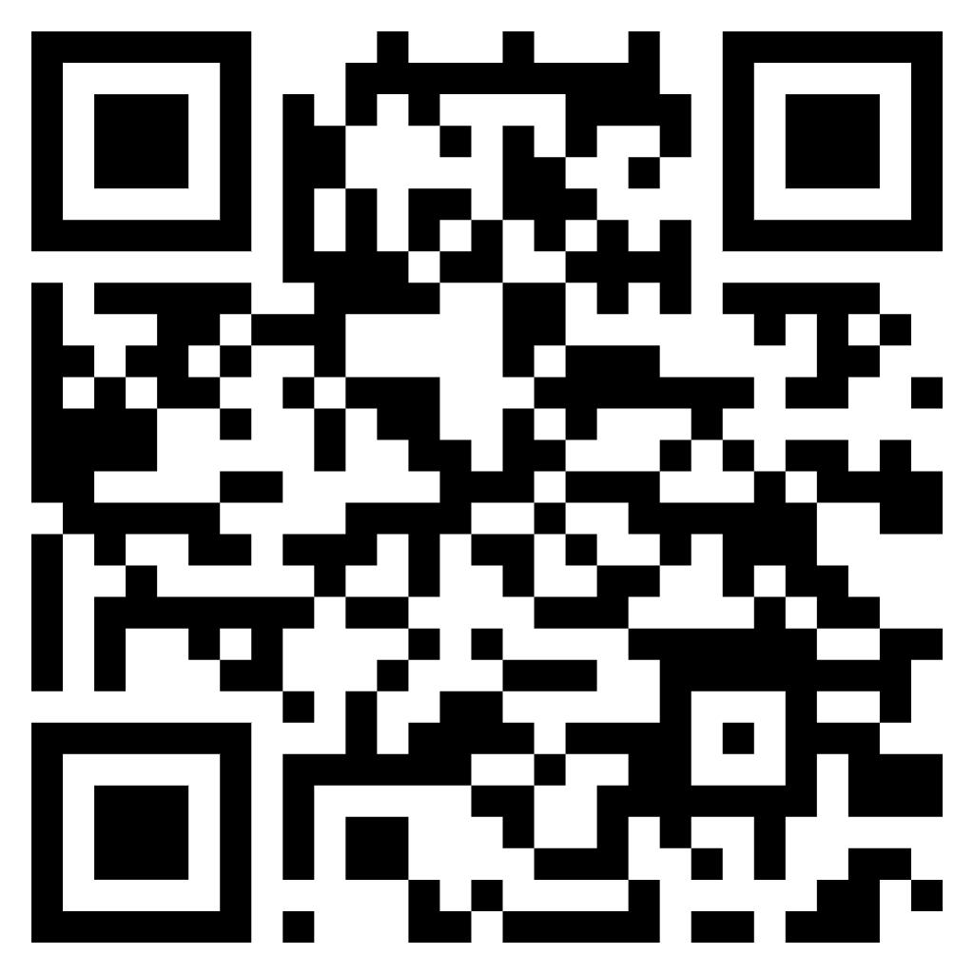
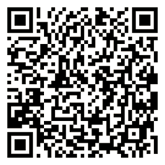
Keep in touch!
Keep in touch
Check out our annual report with over 50 cities and countries factsheets
www.mobiliseyourcity.net
contact@mobiliseyourcity.net
Subscribe to our newsletter
@MobiliseCity
MobiliseYourCity
MobiliseYourCity

