Slide 1
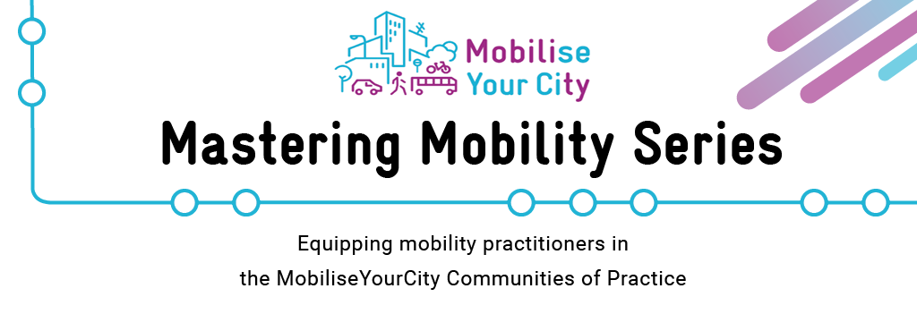

This symbol provides some indication of the time needed for the slide
Alternative Method:
Here we give insights into alternative tools that can be used or alternative means of presentation.
You may also find tips on how to use the slides and exercises in a non-virtual environment
How to use this slide deck
On these slides, you can find the content that will be presented to the participants.
Modifying or Deleting Content: Feel free to modify or delete content to meet your training objectives. However, include the MobiliseYourCity logo on all slides containing content derived from this set of training materials. Refer to the following example slides on how to integrate our content into your presentation.
Copyright Slide: When using any part of our content, please also include the MobiliseYourCity copyright slide in your presentation and mention our training material offer (slide 5)
Notes: You can open the notes to find additional content and speaking points for the presenter, as well as potential further readings and sources to enhance your knowledge.
Margins: The margins provide information on methodological aspects related to the slides and include tips for presenters (e.g. on tasks for participation)
Here you can find some tips related to the slide.
This symbol is related to warnings and important considerations.
For instance, please note that this slide deck is just an example and not completed.
Make sure to open the notes to explore the detailled content for trainers
Zoom out to take a look at the tips and information on methods provided on the margins!
Notes:
This slide is not to be presented.
Please note that this slide deck is mainly meant as an example regarding the layout, structure and use of margins and notes for the presentation. The content presented in the slide deck is not enough to cover 1 module and has to be extended!

Slide 2
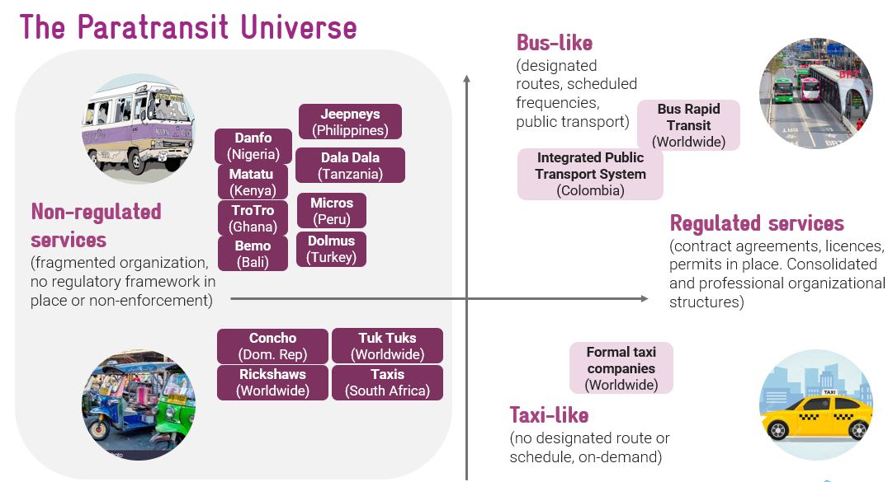
Option 1:
Screenshot our entire slide, integrate it into your presentation and cite:
Source: MobiliseYourCity
along with adding our logo on the bottom right
This is an example of how to quote our slides when integrating them in your presentation
Source: MobiliseYourCity
Notes:
This slide is not to be presented.
Please note that this slide deck is mainly meant as an example regarding the layout, structure and use of margins and notes for the presentation.
Please use ‘Source: MobiliseYourCity’ if our slide is used in its original format.
Including our logo on the bottom right is a ‘must’

Slide 3
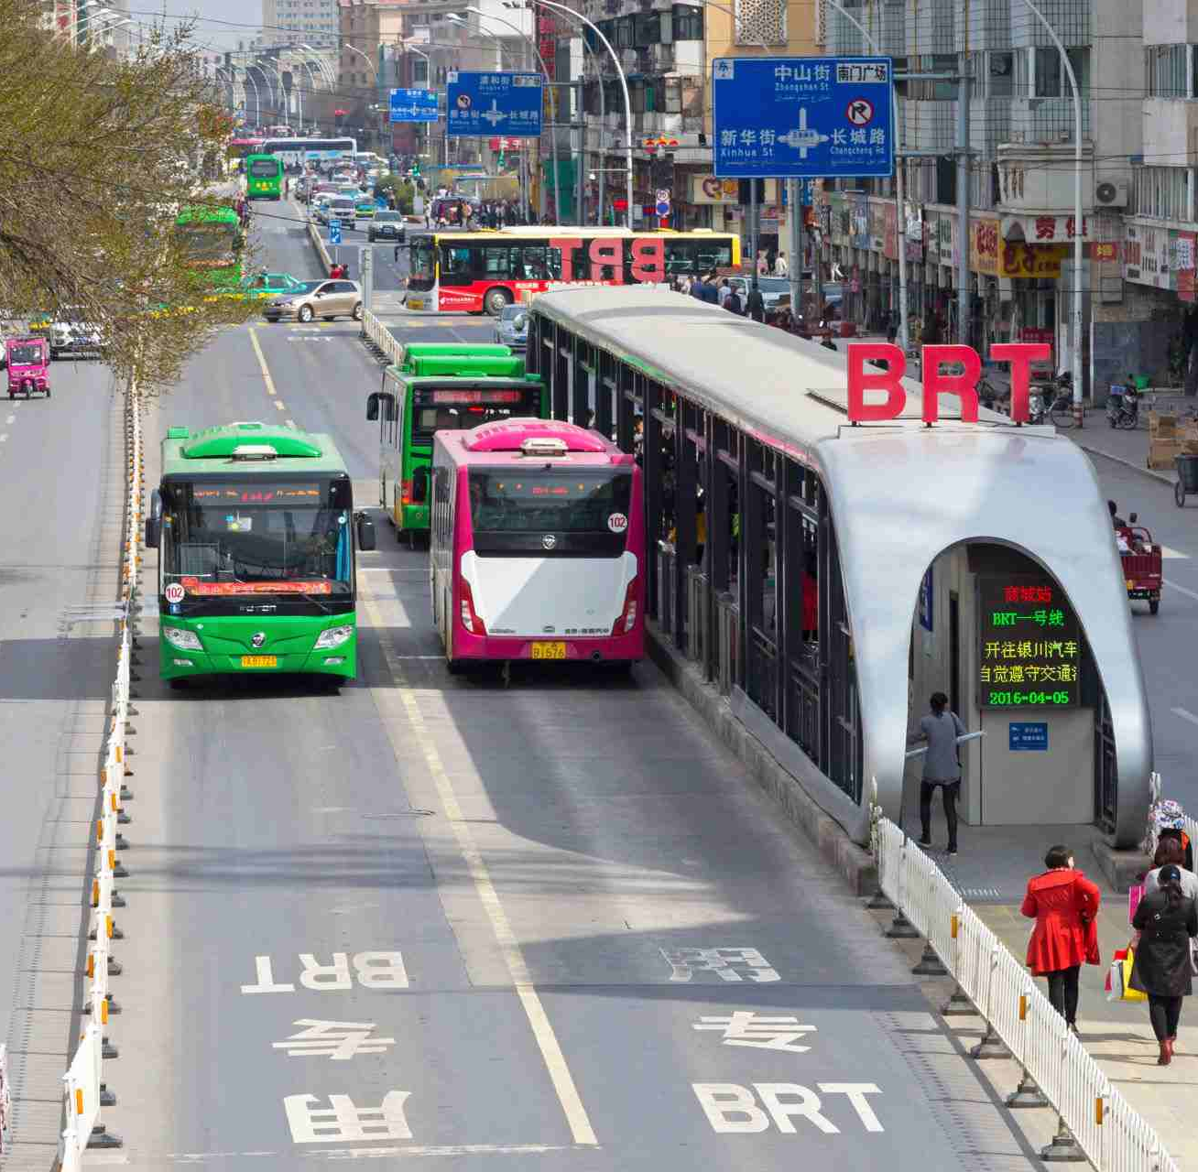

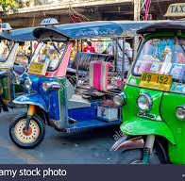
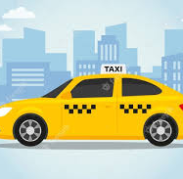
Option 2:
Adjust the content of a slide to fit your layout & and cite:
Content from: MobiliseYourCity
along with adding our logo on the bottom right
The Paratransit Universe
Non-regulated services
(fragmented organization, no regulatory framework in place or non-enforcement)
Regulated services
(contract agreements, licences, permits in place. Consolidated and professional organizational structures)
Danfo
(Nigeria)
Jeepneys (Philippines)
Bus-like
(designated routes, scheduled frequencies, public transport)
Bus Rapid Transit (Worldwide)
Micros
(Peru)
Dala Dala (Tanzania)
Integrated Public Transport System (Colombia)
TroTro
(Ghana)
Matatu
(Kenya)
Bemo
(Bali)
Dolmus
(Turkey)
This is an example of how to quote our slides when integrating them in your presentation
Concho
(Dom. Rep)
Tuk Tuks
(Worldwide)
Taxi-like
(no designated route or schedule, on-demand)
Formal taxi companies (Worldwide)
Rickshaws
(Worldwide)
Taxis
(South Africa)
Content from:
Notes:
This slide is not to be presented.
Please note that this slide deck is mainly meant as an example regarding the layout, structure and use of margins and notes for the presentation.
Please use ‘Content: MobiliseYourCity’ if our slide content was used during your presentation but the layout and theme were changed.
Including our logo on the bottom right is a ‘must’

Slide 4
This slide should be shown before the session starts & during the welcoming words
Defining scenarios & identifying measures to reach urban mobility goals
Don‘t forget to update the date & adjust the title according to your needs
Notes:
Emphasize on the « one size does not fit all »: agencies need to own their own method
The goal is to give them elements to have a critical thinking approach

Slide 5








Aim to spend about 30 secs on this slide
Alternative Method:
Showing this slide is mandatory before the training begins
Training Developed By
Donors:
In collaboration with
Learn more about the MobiliseYourCity Partnership and our replicable training offers: www.mobiliseyourcity.net
Place your organisations logo on the bottom left with the MobiliseYourCity logo and use it as a standard format
Don‘t forget to replace logos for financial donor and partners involved in developing the original training material

Slide 6





Aim to spend about 1 minute on this slide
Alternative Method:
Make sure to change the slides in accordance with the meeting tool you use (e.g. zoom, Webex etc.) and adjust the rules to your context
Some General Notes on this session
CHAT
Make sure you are muted and your camera is turned off
This session will be recorded. You will not appear in the recording if your camera is kept off
Include your questions in the chat, we will pose them in the Q&A at the end of the session
If you want to record the meeting, make sure you tell participants and ask for their consent
Notes:
Before we start – some housekeeping rules:
Keep microphone muted when you are not speaking and your camera turned off if you don’t want to appear in the recording
Raise your hand if you want to speak and unmute yourself once you are asked to speak
Use the chat to comment, participate in votes and quizzes and to exchange with other participants

Slide 7
Aim to spend about 1 minute on this slide
4
Welcome & Housekeeping
Exercise
2
5
Translating The Goals into Scenarios
Q&A, Feedback and Farewell
Update this slide based on your organisational background!
3
What Measures Should We Plan ?

Slide 8
Aim to spend about 1 minute on this slide
Objectives of the session
Understand the articulation between the vision and the plan for mobility development
Appreciate methods of definition of mobility scenarios and measures
Notes:
Emphasize on the « one size does not fit all »: agencies need to own their own method
The goal is to give them elements to have a critical thinking approach
This module offers proven methods in the case of the SUMP for the metropolis of Medan, Indonesia
There is no magic formula to transport planning: each approach must be adapted to the local context (stakeholders, regulations, constraints…)
Integrate it: the tools, entirely or partiallly, can be part of your planning process

Slide 9

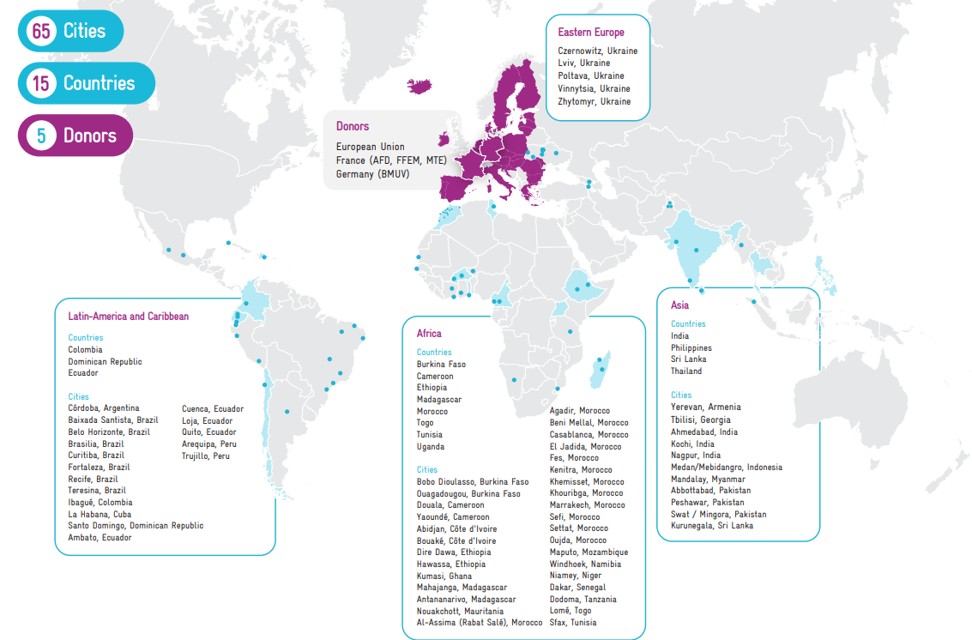
Aim to spend about 1-2 minutes on the introduction of your organisation
MobiliseYourCity - a truly global Partnership with members on 4 continents
You can change this slide to introduce your organisation. We appreciate you mentioning that MobiliseYourCity prepared this training materials and that you are using them now.
Find more information on MobiliseYourCity click here: https://www.mobiliseyourcity.net/
Update this slide based on your organisational background!
Notes:
Introduction to MYC:
Launched at COP21 in Paris, the MobiliseYourCity Partnership is a leading global Partnership for sustainable mobility of nearly 100 partners, including 65 member cities and 15 member countries. It is jointly co-financed by the European Commission's Directorate-General for International Partnerships (DG INTPA), the German Federal Ministry for the Environment, Nature Conservation, Nuclear Safety and Consumer Protection (BMUV), the Agence Française de Développement (AFD), the French Facility for Global Environment (FFEM), and the French Ministry of Ecological Transition (MTE). The Partnership is implemented by AFD, GIZ, ADEME, Cerema, CODATU, EBRD, KFW, and Wuppertal Institute.

Slide 10
Speakers
Aim to spend about 1 minute on this slide
Person 1
Person 2
Person 3
Person 4
Notes:
Introduction of the speakers (moderator & guest speaker) for the webinar
Person 1:
Person 2:
Person 3:
Person 4:

Slide 11
Plan about 30 seconds on this
slide
This slide should briefly introduce this section
1
Translating the Goals into Scenarios

Slide 12
Aim to spend about 2 minutes on this slide
The right moment to define scenarios and measures during the planning process
In the planning process, the scenarios and measures come after the vision and goals for urban mobility are established.
Main step
Inception of the SUMP preparation
Main step
Diagnosis on urban mobility
Main step
Definition of vision and goals
Main step
Preparation of scenarios with measures
Main step
Preparation of the action plan
Clear diagnosis and goals are necessary for having impactful, realistic and relevant scenarios and measures: following the flow between the main steps of the planning is important.
The diagnosis step and its data collection process are key to prepare scenarios that are data-driven and can be evaluated quantitatively.
Quantifying the impacts allows best preparation of the action plan: priorities, costing, etc.
All must participate !
While local stakeholders provide important field insights,
It beneficiates the SUMP to have new views on challenges to identify innovative solutions
Notes:
The clearer the diagnosis is, the more natural the scenarios will be (easily identified).
The scenarios do not appear in the final report : they are a tool to maximize the potential of the action plan by selecting best measures
It is an intermediary step, and coherency of the SUMP shall be observed at this stage

Slide 13
Aim to spend about 2 minutes on this slide
How do we translate the mobility goals into mobility scenarios?
The diagnosis and goals show where we are and where we want to go. The scenarios should tell us how to get there.
Measures are identified: sustainable solutions, identified from benchmarks or brainstorming between stakeholders, adress the painpoints of the reference case. For example, strong congestion at baseline year, topped with forecasts of high growth of vehicles fleet, can be adressed with several measures: financial incentives to reduce car ownership, introduction of shared vehicles, etc. All ongoing or committed measures (ongoing projects) must be included. There can be as many measures as necessary.
Measures are grouped by scenarios: based on the implementing limitations (financial, resources, time, etc.), not all measures can be put in place simultaneously. Likewise, interrelations between measures can be identified following specific goals (e.g. focus on mass transit lines to strongly increase public transport share), thus forming scenarios which fit the established goals. Between 2 to 4 scenarios should appear. Measures can be part of different scenarios.
Reference case
Exisiting conditions at baseline year and foreseeable evolution in future years
Scenario 1
Goals
Envisioned and wished conditions in future years
Scenario 2
Measure 1
Measure 5
Measure 2
Measure 6
Measure 3
Measure 4
Measure 7…
From Main step: Definition of vision and goals
From Main step: Diagnosis on urban mobility
Notes:
If all stakeholders share the same vision, then it will be hard to identify different scenarios. If debates occur, then the discussion is enriched as well as the scenarios.
It can be possible that measures are more easily ientified than scenario : do not hesitate to start with the measures. Scenarios can be formed in parallel or afterwards
It is important to help the process that stakeholders think far and wide instead of their absolute priority as institutions: long and short terms, whole greographies instead of localized measures, various modes instead of a specific one…

Slide 14
Aim to spend about 2 minutes on this slide
If we already know the measures, why do we need scenarios?
Through several iterations, the scenarios help refining the measures themselves and consolidate a consensual roadmap.
The scenarios, as a combination of measures, help identify their compatibility and feasibility. The limitation of the resources (financial, human) show which measures could and could not be implemented in parallel.
The early identification of measures and their description gives way to early implementation schedules, stakeholders roles assignment, focus on certain geographical areas, depending on the readiness of institutions.
Several examples of focuses for the scenarios are shown below:
Geographical examples
Modes examples
Priorities examples
Scenario 1: Towards a metropolitan connectivity
Scenario 1:Focus on mass transit projects
Scenario 1: Equal safety for all mobilities
Scenario 2: Densifying core hubs of the city
Scenario 2: Maximization of road use (road-based PT and soft modes)
Scenario 2: Accessibility to mobility for all communities
Scenario 3: Bridging peripheral and core areas
Scenario 3: Mobility projects as a vector of economic growth
Notes:
The important factor is the acceptability of the scenarios that must show realistic chains of events
If a scenario seems too “ideal” or “impossible to implement”, then it must be reformulated or restructured.

Slide 15
Aim to spend about 2 minutes on this slide
Key principles for the scenario's definition
The scenarios must be realistic and allow for reaching the goals set out before.
Scenarios must reflect the goals of mobility development realistically
Scenarios are not frozen : they are a tool to lead to the action plan of the SUMP, which is the real roadmap
They are evaluated against the reference case (2020 onwards without additional measures) and between themselves
Scenarios will be evaluated on economic, technical, financial, institutional feasibilities
Scenarios contain measures: at the end and for the action plan, several measures from different scenarios are combined together
Notes:
The important factor is the acceptability of the scenarios that must show realistic chains of events
If a scenario seems too “ideal” or “impossible to implement”, then it must be reformulated or restructured.

Slide 16
Aim to spend about 2 minutes on this slide
Case study: tailoring the Mebidangro urban mobility goals
Medan Region Case Study
Building a sustainable, integrated and equitable transportation system for Mebidangro…
A convenient and well-connected transport network
Improved comfortability, punctuality, and connectivity of public transport network in Mebidangro, that enables people to travel faster in a more convenient manner from their home to their daily activity, through improving inter-modal connectivity, improvement of current transport assets, effective land use planning and new mass transit system.
Tackling the current and potentially growing issues of congestion
The current and potentially growing issue of congestion is one of the most pressing problem in Mebidangro. Strategies to minimize the growth of private vehicle is needed alongside the development of public transport system, better traffic management and implementation of traffic calming measures to improve traffic safety and comfortability.
An inclusive infrastructure that improves accessibility and enables safer journeys
Promote barrier free journey for all communities through the development of inclusive infrastructures (both within the transport vehicle and supporting infrastructures i.e. bus stops, pedestrian, etc.), that improves accessibility and enables safer and enjoyable journey for all citizens.
An environmentally-friendly transport ecosystem that improves urban livability
Promote an environmentally-friendly transport ecosystem to reduce emission, improve urban livability and promote healthier environment and communities though the use of more sustainable energy, incentive to reduce the usage of fuel, activating walking and cycling infrastructures and activating community spaces to improve safety and connectivity.
An effective transport governance
Sustainable financing of transport system
…within an enabling environment

Slide 17
Aim to spend about 2 minutes on this slide
Case study: tailoring the Mebidangro urban mobility goals
Medan Region Case Study
These are propositions for realistic scenarios as a base for discussion.
Scenario 1 : Reference case
The current situation evolves as usual in horizon years, and projects that are already committed in the baseline year 2020 are implemented.
Scenario 2 : Conventional
Priority is given to calm mobility, safety, improvement of existing assets, and organized land use with a territorial approach. Investments are kept minimum and current assets are optimized, with minimum ambition
Scenario 3 : Ambitious
Mass transit implementation and changes in the governance of mobility for Mebidangro. Investments are important and there is strong support for a change of paradigm.
At the end, scenarios can be mixed depending on positive aspects: scenarios are just a tool.
Notes:
.

Slide 18
Plan about 30 seconds on this
slide
This slide should briefly introduce this section
2
What Measures Should We Plan ?

Slide 19
Aim to spend about 2 minutes on this slide
How do we select measures?
The measures shall stem from local agencies for best ownership.
List the challenges of urban mobility identified in the diagnosis (previous step of SUMP)
Brainstorm with stakeholders to find solutions against mobility challenges, use benchmarks
Insure compatibility with already planned and committed developments, as well as inclusion of ongoing projects (the SUMP does not cancel already planned projects – but helps formalize them within a wider framework).
Measures shall cover all transport modes (NMT, pedestrian, private vehicles, public transport, freight) on all time horizons (short, medium, long terms).
Measures can be as numerous as needed, and shall not be differentiated following the responsibility of the public or private sector: the government agency has a role in all of them.
Tool : Sundberg Cakes
Notes:
It is the dream occasion for all stakeholders to voice out their views and wishes on measures to implement
If brainstorm is inconclusive or not comprehensive, we can adopt methods such as Sundberg cakes. Otherwise, avoid strict methods and rather let the stakeholders voice out their views and interests.

Slide 20
Aim to spend about 2 minutes on this slide
How do we select measures?
The measures shall stem from local agencies for best ownership.
All measures shall be ad-hoc and specific to the local context: importance of culture, acceptation, and readiness (e.g. in least developed cities, avoid solutions such as electric shared vehicles, which are susceptible of not being accepted).
Possible to use tools, such as the Sundberg Cakes to foster ideas for measures
  Urban Transport roadmaps : www.urban-transport-roadmaps.eu
  KonSULT Measure Option Generator : www.konsult.leeds.ac.uk
Rest of the refinement process for the measures is presented in the last section.
Tool : Sundberg Cakes
Notes:
It is the dreamt occasion for all stakeholders to voice out their views and wishes on measures to implement
If brainstorm is inconclusive or not comprehensive, we can adopt methods such as Sundberg cakes. Otherwise, avoid strict methods and rather let the stakeholders voice out their views and interests.

Slide 21
Aim to spend about 2 minutes on this slide
Identifying the right scenarios & timeframe for each measure
Whether scenarios or measures are identified first, a coherent split shall be observed
Measures can be part of one or several scenarios as long as the integrated packages are coherent and realistic.
One measure can be differentiated following different scenarios:
  For example, Measure A is part of Scenario 1 on the short term; And part of Scenario 2 on the long term.
  For example, Measure A is part of Scenario 1 under private sector; And part of Scenario 2 under public sector.
The resulting packages shall have a similar number of measures, and cover multiple modes and time horizons. Although scenarios are of different natures, they shall all be comprehensive in terms of time and coverage.
Whether scenarios or measures are identified first, a coherent split shall be observed
by type of measure (for a mix of land use, infrastructure, regulation, management and service, information and pricing, etc.),
by acceptability (grouping popular and less popular but effective measures into packages, e.g. incentives and restrictions),
by objective or challenge (adding measures that contribute to the same objective or solve the same problem to a package)
by geography (combining measures in the same area into one package)

Slide 22
Aim to spend about 2 minutes on this slide
Identifying the right scenarios & timeframe for each measure
Whether scenarios or measures are identified first, a coherent split shall be observed
by costs (combining an effective but expensive key measure with measures that create revenues to achieve lower net costs)
by bundling for external financing (grouping measures in need of external financing that: i) support one clearly defined objective; ii) are implemented in the same impact area; iii) share the same project owner; and iv) have similar implementation periods)
around larger projects (such as a new bike network, seeking measures which complement and reinforce that project such as bikelanes, bike parkings, etc.)
Whether scenarios or measures are identified first, a coherent split shall be observed
In an iterative approach, timelines of measures can be modified to make the scenarios more coherent and realistic.
The distribution of measures within time and scenarios shall not be frozen: the updates of SUMP in future years shall refine them thanks to the MRV process, and new measures shall be identified in the medium-term following the evolution of the situation

Slide 23
Aim to spend about 1 minute on this slide
What measures should we implement?
6 general themes
Urban, land use, and social
Road & private vehicles
Sustainable mobility
(public transport & NMT)
Digitalization
Governance
(regulatory & financial)
Environment & air quality

Slide 24
Aim to spend about 2 minutes on this slide
Identification of measures: what should we do? Add / delete
Medan Region Case Study
Add measures to Scenario 1 if necessary – and add or delete measures in Scenario 2 and 3.
 |  | Scenario 1 |  | Scenario 2 |  | Scenario 3
No | Measures | Reference |  | Conservative |  | Disruptive
1 | Car-free zones |  |  | Short 2023
2 | Mixed-use zones in secondary urban centers |  |  |  |  | Medium 2028
3 | Reinforce driving license process |  |  | Short 2023
4 | Road safety campaigns, especially at black spots |  |  | Short 2023 |  | Short 2023
5 | Promote public transportation |  |  |  |  | Short 2023
6 | Framework for TOD developments |  |  |  |  | Medium 2028
7 | Comfortable and safe sidewalks |  |  | Medium 2028 |  | Medium 2028
8 | Land Value Capture law |  |  |  |  | Medium 2028
Urban, land use, and social
Road & private vehicles
Sustainable mobility
(public transport & NMT)
Digitalization
Governance
(regulatory & financial)
Environment & air quality

Slide 25
Aim to spend about 2 minutes on this slide
Identification of measures: what should we do? Add / delete
Medan Region Case Study
Add measures to Scenario 1 if necessary – and add or delete measures in Scenario 2 and 3.
 |  | Scenario 1 |  | Scenario 2 |  | Scenario 3
No | Measures | Reference |  | Conservative |  | Disruptive
9 | Circular roads | Medium 2028 |  | Medium 2028 |  | Medium 2028
10 | Enhance road link Medan - Berastagi |  |  | Medium 2028 |  | Medium 2028
11 | Standardized road signage accross Mebidangro |  |  | Medium 2028 |  | Medium 2028
12 | Traffic calming measures, in city center and periphery |  |  | Short 2023
13 | Dedicated parking hubs |  |  | Medium 2028 |  | Medium 2028
14 | One-way streets |  |  | Short 2023 |  | Short 2023
15 | Traffic law enforcement |  |  | Short 2023 |  | Short 2023
16 | Signs informing of vehicle real-time speeds |  |  |  |  | Short 2023
17 | Park & ride at public transportation hubs |  |  |  |  | Medium 2028
18 | Quality road network all accross Mebidangro |  |  | Medium 2028 |  | Medium 2028
19 | Limit freight vehicles to night travel |  |  |  |  | Short 2023
Urban, land use, and social
Road & private vehicles
Sustainable mobility
(public transport & NMT)
Digitalization
Governance
(regulatory & financial)
Environment & air quality

Slide 26
Aim to spend about 2 minutes on this slide
Identification of measures: what should we do? Add / delete
Medan Region Case Study
Add measures to Scenario 1 if necessary – and add or delete measures in Scenario 2 and 3.
 |  | Scenario 1 |  | Scenario 2 |  | Scenario 3
No | Measures | Reference |  | Conservative |  | Disruptive
20 | BRT line 1 |  |  | Short 2023 |  | Short 2023
21 | Wider BRT network |  |  |  |  | Long 2035
22 | Wider city buses network |  |  | Medium 2028
23 | Implement waterbuses |  |  | Medium 2028
24 | Urban rapid rail lines (tramway, LRT, MRT TBD) |  |  |  |  | Medium 2028
25 | Tramway and/or tram-train |  |  | Short 2023 |  | Short 2023
26 | Increase service levels of existing rail |  |  | Short 2023
27 | Increase quality of existing minibuses |  |  |  |  | Medium 2028
28 | Increase quality of service of existing buses |  |  | Short 2023
29 | School buses |  |  | Short 2023
30 | Employee buses |  |  | Short 2023
31 | Safe NMT ways |  |  |  |  | Short 2023
32 | Key multimodal hubs |  |  | Medium 2028 |  | Medium 2028
Urban, land use, and social
Road & private vehicles
Sustainable mobility
(public transport & NMT)
Digitalization
Governance
(regulatory & financial)
Environment & air quality

Slide 27
Aim to spend about 2 minutes on this slide
Identification of measures: what should we do? Add / delete
Medan Region Case Study
Add measures to Scenario 1 if necessary – and add or delete measures in Scenario 2 and 3.
 |  | Scenario 1 |  | Scenario 2 |  | Scenario 3
No | Measures | Reference |  | Conservative |  | Disruptive
33 | Carpooling |  |  | Short 2023
34 | Monitoring system at Mebidangro level |  |  |  |  | Medium 2028
35 | Passenger information in real-time & at stations |  |  | Short 2023 |  | Short 2023
36 | MaaS (on-demand services) |  |  | Short 2023
37 | Fare intermodality |  |  | Medium 2028
Urban, land use, and social
Road & private vehicles
Sustainable mobility
(public transport & NMT)
Digitalization
Governance
(regulatory & financial)
Environment & air quality

Slide 28
Aim to spend about 2 minutes on this slide
Identification of measures: what should we do? Add / delete
Medan Region Case Study
Add measures to Scenario 1 if necessary – and add or delete measures in Scenario 2 and 3.
 |  | Scenario 1 |  | Scenario 2 |  | Scenario 3
No | Measures | Reference |  | Conservative |  | Disruptive
38 | Mebidangro transit authority |  |  |  |  | Medium 2028
39 | Reform minibus industry under Province |  |  |  |  | Medium 2028
40 | Corporate tax on mobility |  |  |  |  | Medium 2028
41 | Capacity building (Technical Assistance) |  |  | Short 2023 |  | Short 2023
42 | Law to restrict urban sprawl |  |  | Long 2035 |  | Long 2035
43 | Separate track and train operators |  |  |  |  | Medium 2028
Urban, land use, and social
Road & private vehicles
Sustainable mobility
(public transport & NMT)
Digitalization
Governance
(regulatory & financial)
Environment & air quality

Slide 29
Aim to spend about 2 minutes on this slide
Identification of measures: what should we do? Add / delete
Medan Region Case Study
Add measures to Scenario 1 if necessary – and add or delete measures in Scenario 2 and 3.
 |  | Scenario 1 |  | Scenario 2 |  | Scenario 3
No | Measures | Reference |  | Conservative |  | Disruptive
44 | Tax on motorized vehicles using urban roads |  |  | Medium 2028 |  | Medium 2028
45 | Incentives to reduce fuel consumption |  |  | Short 2023
46 | Remove fuel subsidy within city |  |  |  |  | Medium 2028
47 | Renewable energies for rail transportation |  |  |  |  | Short 2023
48 | Renewable energies for road public transportation |  |  | Medium 2028
49 | Renewable energies for private vehicles |  |  |  |  | Medium 2028
Urban, land use, and social
Road & private vehicles
Sustainable mobility
(public transport & NMT)
Digitalization
Governance
(regulatory & financial)
Environment & air quality
Notes:
Insights
- The breakdown proposed is just an example. Instead of four blocks, we could prefer a geographical approach, zonal approach, mode approach, etc.

Slide 30
Aim to spend about 1 minute on this slide
Iterations towards the scenario comparison
CONCLUSION
Transport modelling
Measures
identification
Measures
Confirmation and prioritization
Check if in line with policies and goals…
Measures
Refinement & modelling
Definition of mass transit route…
Preliminary location of hubs…
Measures
quantification
Preliminary budget analysis…
Traffic and environmental impacts…
Measures
evaluation
Evaluation of impacts…
Technical, financial, institutional feasibility…
Scenario comparison and selection
Evaluation of each scenario and selection
Committee
Committee
Consultant work mainly

Slide 31
Aim to spend about 1 minute on this slide
The measures are refined and modelled
CONCLUSION
Measures
Identification
Benchmark best solutions to address mobility challenges from diagnosis, Brainstorm measures with stakeholders
List as many measures as necessary - Ensure all modes are covered on short medium and long terms
Measures can be under private sector
More examples: https://sumps-up.eu/publications-and-reports/
What do we need to do to reach our goals?
Committee
Measures
Confirmation and Prioritization
Verify acceptability of measures: regulations, sustainability, etc.
Consult with stakeholders regarding local readiness and acceptability of measures, adequation with local culture.
Verify that measures are not against nor overlapping already planned or implemented measures, and plans from other areas
Identify structural measures (main priorities) and secondary ones (not urgent)
Is it compatible with the wider context of the city?
Measures
Refinement & Modelling
Geographical refinement of the measures: definition of districts involved, refinement of the transport corridors, streets subject to receive sidewalks, etc.
Qualitative refinement of the measures: type of technologies possible, stations high-level identification, identification of multimodal hubs possible…
What specs do we need to know to describe the measures?
tbc

Slide 32
Aim to spend about 1 minute on this slide
The measures are refined and modelled
CONCLUSION
Characterization of the measure in more details: estimation of size of the systems, fleets, effort needed, land required, etc.
High-level estimation of costing (CAPEX and OPEX) and implementation schedule
High-level estimation of readiness of stakeholders for its implementation, identification of government agency scope
Forecast demand of mobility systems wherever possible (transit lines, vehicle sharing…)
What resources do we need to implement the measures?
Measures
Quantification
Measures
Evaluation
Evaluation of financial, technical, institutional, risk, environmental aspects of the measures in quantity wherever possible – otherwise, with expert opinions
The scoring gives best measures. Measures which do not score the highest can be improved by re-iterating the process.
The measures scores are used to evaluate the scenarios.
How do the measures score and how can we improve them ?
Scenario Comparison & Selection
The scenarios are evaluated thanks to the scores of their measures (possible to integrate ponderations).
It is recommended to use a Multi-Criteria Analysis tool given the multiplicity of measures and plurality of aspects to evaluate, at different scales and on different timelines.
The scenario scoring the highest is selected to develop the Action Plan.
How do the measures score and how can we improve them ?
tbc

Slide 33
Plan to spend 10 minutes on this section
3
Breakout Groups

Slide 34
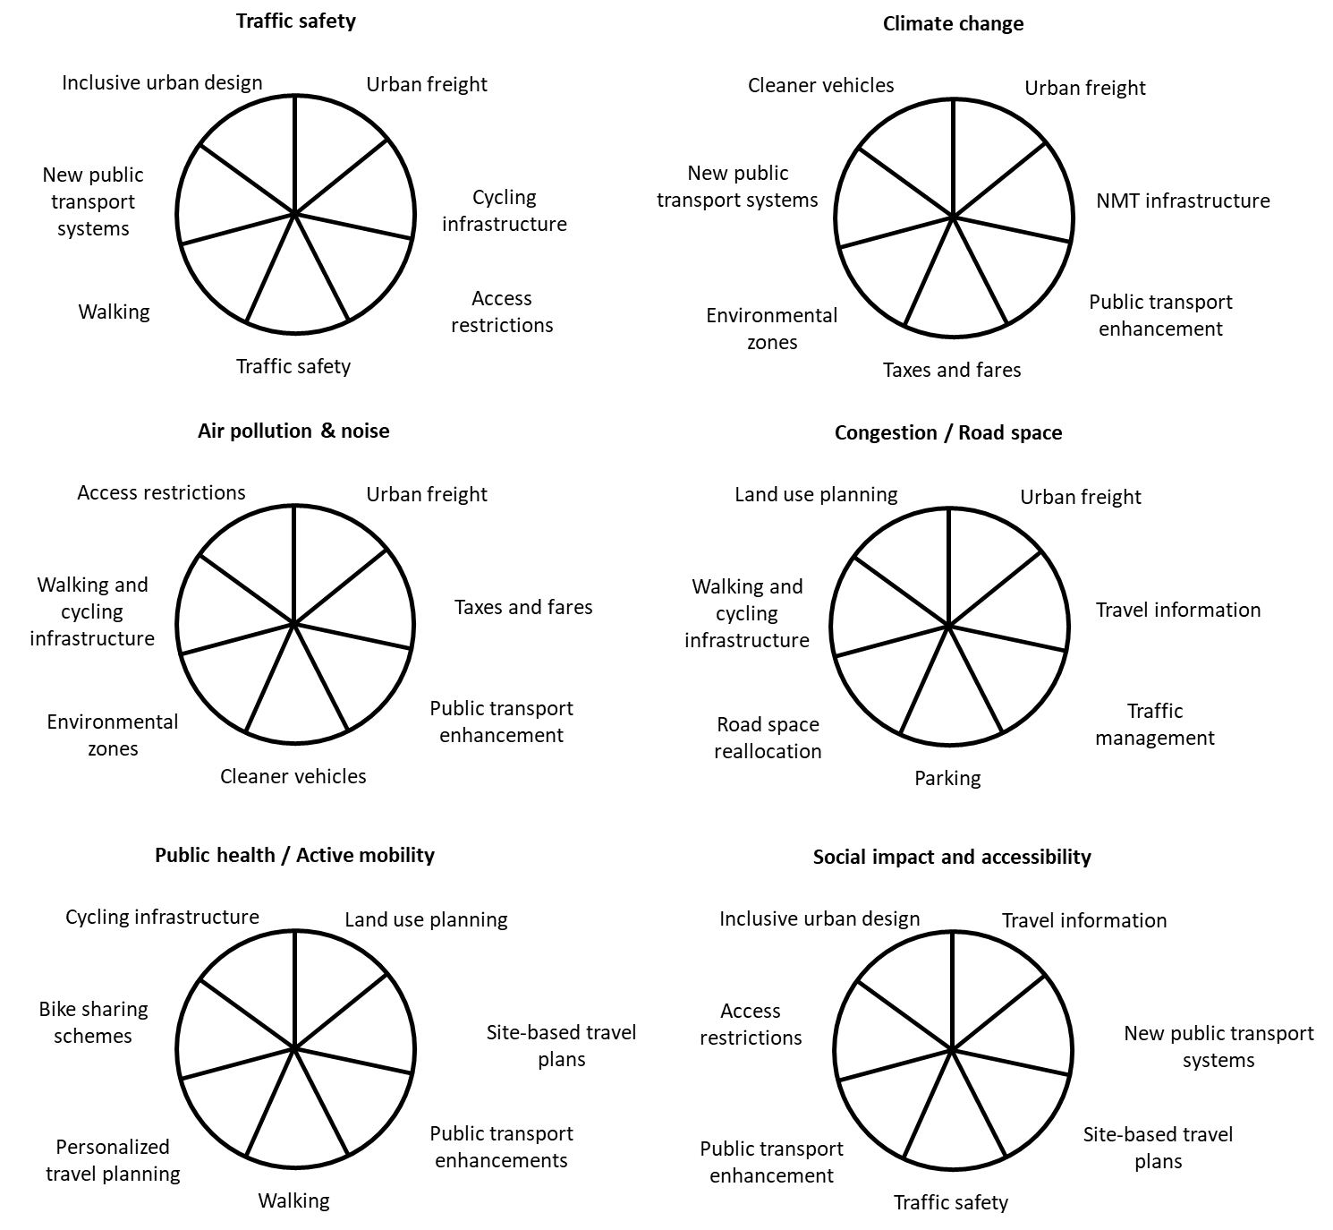
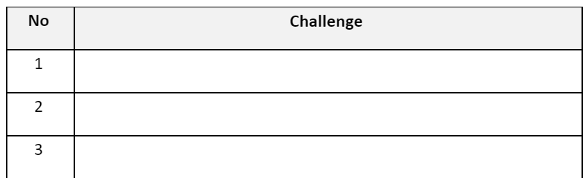
Aim to spend about 1-2 minutes on this slide
Identify 3 main challenges for urban mobility observed in your city.
Identify 3 main challenges for urban mobility in your city
Example: Casualties from road traffic increase every year on main axes.
For each challenge, fill up the related Sundberg pie-charts for measures identification with the illustrations below.
Example: Measures identification with Sundberg pie-chart to address the challenge “Casualties from road traffic increase yearly on main axes.
Have an assistant ready to post the link in the chat
Notes:
The moderator creates break out groups. It is important to make sure that there is a moderator/ speaker/ or host in each group to moderate the exercise.
In each break-out group, participants asked to identify their three main challenges for urban mobility observed in your city. For example: Casualties from road traffic increase every year on main axes.
For each challenge, fill up the related Sundberg pie-charts for measures identification with the illustrations below. Example: Measures identification with Sundberg pie-chart to address the challenge “Casualties from road traffic increase every year on main axes.”

Slide 35
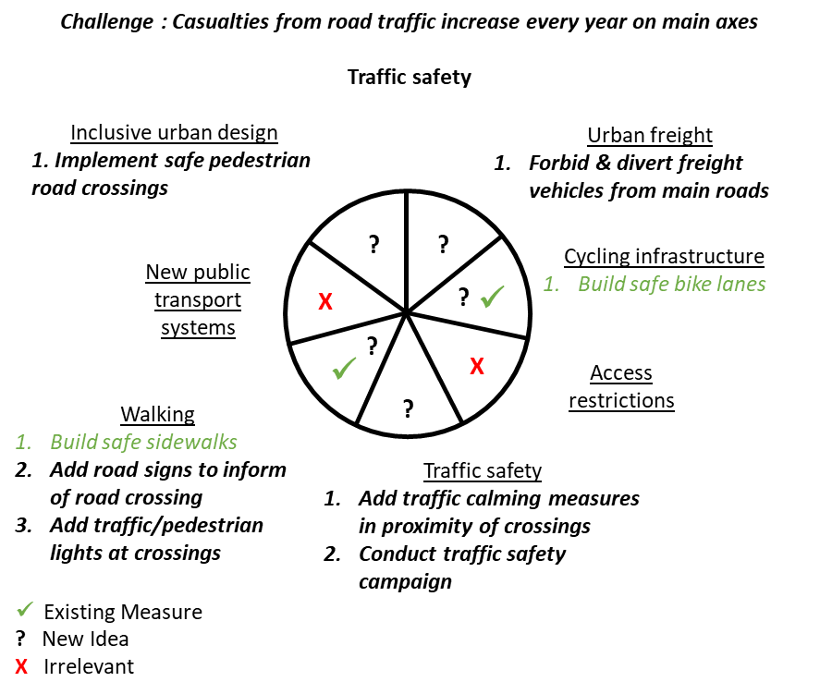
Aim to spend about 1 minute on this slide
Identify 3 main challenges for urban mobility observed in your city.
For each challenge, fill up the related Sundberg pie-charts for measures identification with the illustrations below.
Example: Measures identification with Sundberg pie-chart to address the challenge “Casualties from road traffic increase every year on main axes.
This is the answer to the breakout group tasks but you could develop a similar slide for your session
Have an assistant ready to post the link in the chat

Slide 36

Introduce this section briefly
4
Questions, Feedback and Farewell?

Slide 37




Spend about 3-4 minutes on this slide (if time allows)
Alternative Method:
Open up the microphone for any participant willing to ask a question, comment on the presentation or share their own experience.
If there is not enough time to go over all the questions, ask participants to send them on the chat or by email and tell them that they will be answered later.
Q&A
Chat
Speak
Post your questions in the chat and we will include them in the Q&A
Select “Show reactions” in the meeting controls, and then choose “Raise your hand”. Everyone in the meeting will see that you've got your hand up.
Go through the questions sent on the chat and filter by those that have not been answered and cluster them by topic.
The moderator should filter the questions and give the floor to the most suitable speaker to answer
Remember to thank participants and the guest speakers for their contributions, insights, comments and questions
Notes:
Remember to thank the participants for the session, their contributions and insights.
Thank the guest speakers for their experience and sharing their own experience.
Types of questions you could receive:

Slide 38


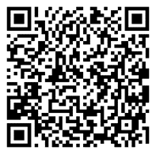
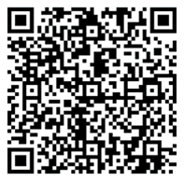
Plan about 1 minute on this slide
Stay tuned with MobiliseYourCity updates
Eager for more? subscribe to the MobiliseYourCity newsletter to stay updated with the latest information on our upcoming Mastering Mobility Sessions!
Register here or scan the QR Code
Please ask the participants to subscribe to our newsletter if they liked the content of our training material and want to stay updated for further sessions:
Share this link in the chat: Register here
Also, please promote our knowledge platform amongst participants for accessing latest publications.
Share the link in the chat:
Knowledge Platform
Missed previous past sessions? The recordings are available on their Knowledge Platform!
Visit Knowledge Platform here or scan the QR Code
Notes:
Please ask the participants to subscribe to our newsletter if they liked the content of our training material and want to stay updated for further sessions. Share this link in the chat: Register here
Also, please promote our knowledge platform amongst participants for accessing latest publications. Share the link in the chat: Knowledge Platform

Slide 39
Thank you for your attention
Keep in touch
Mobiliseyourcity.net
contact@mobiliseyourcity.net
@MobiliseCity
MobiliseYourCity
MobiliseYourCity

