Slide 1


This symbol provides some indication of minimum time needed for the slide
Alternative Method:
Here we give insights into alternative tools that can be used or alternative means of presentation.
You may also find tips on how to use the slides and exercises in a non-virtual environment
How to use this slide deck
On these slides, you can find the content that will be presented to the participants.
Modifying or Deleting Content: Feel free to modify or delete content to meet your training objectives. However, include the MobiliseYourCity logo on all slides containing content derived from this set of training materials. Refer to the following example slides on how to integrate our content into your presentation.
Copyright Slide: When using any part of our content, please also include the MobiliseYourCity copyright slide in your presentation and mention our training material offer (slide 5)
Notes: You can open the notes to find additional content and speaking points for the presenter, as well as potential further readings and sources to enhance your knowledge.
Margins: The margins provide information on methodological aspects related to the slides and include tips for presenters (e.g. on tasks for participation)
Here you can find some tips related to the slide.
This symbol is related to warnings and important considerations.
For instance, please note that this slide deck is just an example and not completed.
Make sure to open the notes to explore the detailled content for trainers
Zoom out to take a look at the tips and information on methods provided on the margins!
Notes:
This slide is not to be presented.
Please note that this slide deck is mainly meant as an example regarding the layout, structure and use of margins and notes for the presentation. The content presented in the slide deck is not enough to cover 1 module and has to be extended!

Slide 2
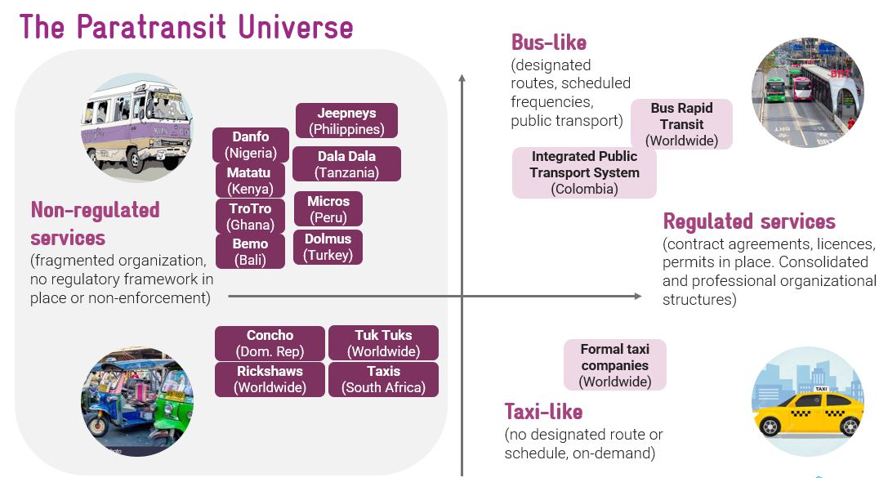
Option 1:
Screenshot our entire slide, integrate it into your presentation and cite:
Source: MobiliseYourCity
along with adding our logo on the bottom right
This is an example of how to quote our slides when integrating them in your presentation
Source: MobiliseYourCity
Notes:
This slide is not to be presented.
Please note that this slide deck is mainly meant as an example regarding the layout, structure and use of margins and notes for the presentation. Please use ‘Source: MobiliseYourCity’ if our slide is used in its original format. Including our logo on the bottom right is a ‘must’

Slide 3
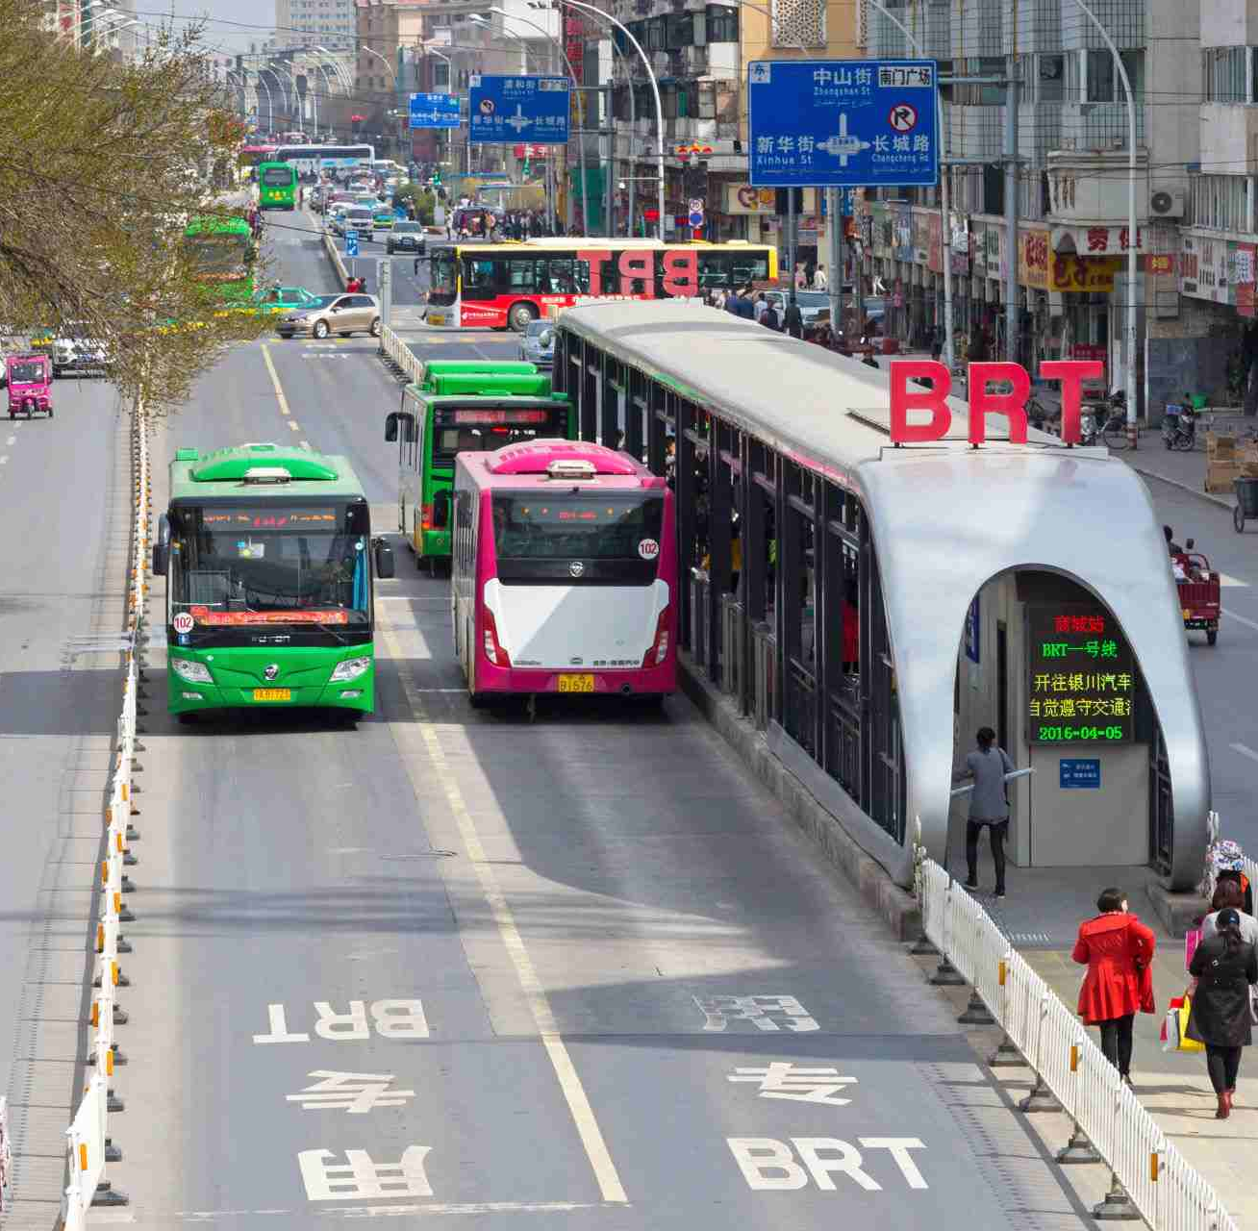

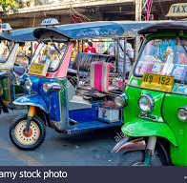

Option 2:
Adjust the content of a slide to fit your layout & and cite:
Content from: MobiliseYourCity
along with adding our logo on the bottom right
The Paratransit Universe
Non-regulated services
(fragmented organization, no regulatory framework in place or non-enforcement)
Regulated services
(contract agreements, licences, permits in place. Consolidated and professional organizational structures)
Danfo
(Nigeria)
Jeepneys (Philippines)
Bus-like
(designated routes, scheduled frequencies, public transport)
Bus Rapid Transit (Worldwide)
Micros
(Peru)
Dala Dala (Tanzania)
Integrated Public Transport System (Colombia)
TroTro
(Ghana)
Matatu
(Kenya)
Bemo
(Bali)
Dolmus
(Turkey)
This is an example of how to quote our slides when integrating them in your presentation
Concho
(Dom. Rep)
Tuk Tuks
(Worldwide)
Taxi-like
(no designated route or schedule, on-demand)
Formal taxi companies (Worldwide)
Rickshaws
(Worldwide)
Taxis
(South Africa)
Content from:
Notes:
This slide is not to be presented.
Please note that this slide deck is mainly meant as an example regarding the layout, structure and use of margins and notes for the presentation. Please use ‘Content: MobiliseYourCity’ if our slide content was used during your presentation but the layout and theme were changed. Including our logo on the bottom right is a ‘must’

Slide 4
This slide should be shown before the session starts & during the welcoming words
Data Types and Data Collection
for Urban Mobility Diagnosis
Don‘t forget to update the date & adjust the title according to your needs
Some participants might join a bit late; consider waiting 1-3 minutes until people enterthe meeting room​
Notes:
Warm welcome to participants
Topic of the session: Paratransit and links to sustainability
Duration of the session: approximately 2h including break, interactive session etc. → time for questions and exchange

Slide 5








Aim to spend about 30 secs on this slide
Alternative Method:
Showing this slide is mandatory before the training begins
Training developed by
Donors:
In collaboration with
Learn more about the MobiliseYourCity Partnership and our replicable training offers: www.mobiliseyourcity.net
Place your organisations logo on the bottom right with the MobiliseYourCity logo and use it as a standard format
Don‘t forget to replace logos for financial donor and partners involved in developing the original training material

Slide 6






Aim to spend about 1 minute on this slide
Alternative Method:
Make sure to change the slides in accordance with the web meeting tool you use (e.g. Zoom, Webex, etc.) and adjust the rules to your context
Some general notes on this session
CHAT
Make sure you are muted and your camera is turned off
This session will be recorded. You will not appear in the recording if your camera is kept off
Include your questions in the chat, we will pose them in the Q&A at the end of the session
Don’t hesitate to share your ideas, comments and questions in the chat!
If you want to record the meeting, make sure you tell participants and ask for their consent
Notes:
Before starting – some housekeeping rules:
Remind participants that the session will be recorded (if that’s the case)
Keep microphone muted when you are not speaking and your camera turned off if you don’t want to appear in the recording
Raise your hand if you want to speak and unmute yourself once you are asked to speak
Use the chat to comment, participate in polls and quizzes and to exchange with other participants. On the chat it is possible to share links with relevant content

Slide 7
Spend around 1 minute on this slide
Objectives of the session
Define an urban mobility diagnosis and understand why it’s essential to do one as part of an urban mobility planning process ​
Identify the requirements and steps for conducting an urban mobility diagnosis​
Define the types of data needed to conduct an urban mobility diagnosis​
Reflect on how to close data gaps in low-data environments
Notes:
The objective of this session is understand why data collection is an essential part of an urban mobility diagnosis. After participating in this webinar, you should be able to:
Define an urban mobility diagnosis and understand why it’s essential to do one as part of an urban mobility planning process ​
Identify the requirements and steps for conducting an urban mobility diagnosis​
Define the types of data needed to conduct an urban mobility diagnosis​
Reflect on how to close data gaps In low data environments

Slide 8
Spend 2 minutes describing the structure of the contents of the trainning
5
Welcome and Housekeeping
Types of Mobility Surveys
2
6
Icebreaker
Methods of Data Collection
3
7
Urban Mobility Diagnosis: Context of SUMP
Exercise
Make necessary adjustments based on the contents to present. E.g. include local case studies, different interactive exercises, etc.
4
8
Why Mobility Surveys?
Questions, Feedback and Farewell
Notes:
Today’s session will last approximately 90 minutes. In this session we are going to discuss three main aspects:
First, why is it essential to do data collection throughout the SUMP planning process, specially in the diagnosis phase
Second, what are the main types of data that one needs to collect and also
Thirds, what are the main methodologies that could be used for the collection process

Slide 9
Spend 2 minutes introducing the speakers and their background
Speakers
Adjust the number of speakers using the slide templates
Notes:
Introduction of the speakers (moderator & guest speaker) for the webinar
Person 1: Name- Designation
Person 2: Name- Designation
Person 3: Name- Designation
Person 4: Name- Designation
Introduce your organisation, speakers and their areas of expertise and focus

Slide 10

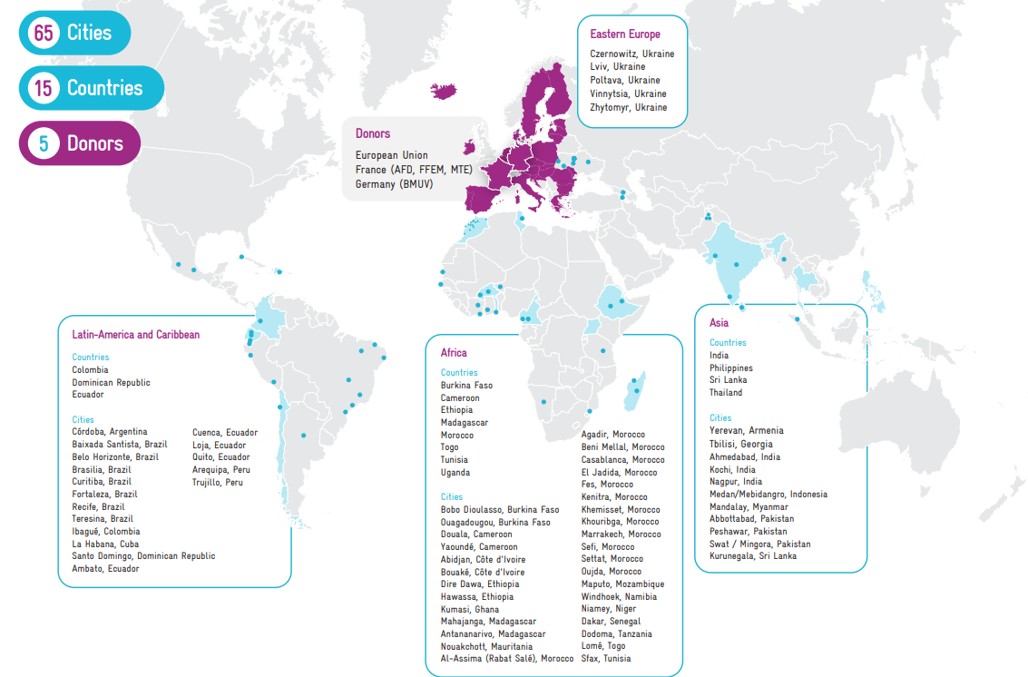
Aim to spend about 2-3 minutes on the introduction of your organisation
MobiliseYourCity - a truly global Partnership with members on 4 continents
You can change this slide to introduce your organisation. We appreciate you mentioning that MobiliseYourCity prepared this training materials and that you are using them now.
Find more information on MobiliseYourCity click here: https://www.mobiliseyourcity.net/
Update this slide based on your organisational background!
Notes:
Introduction to MYC:
Launched at COP21 in Paris, the MobiliseYourCity Partnership is a leading global Partnership for sustainable mobility of nearly 100 partners, including 65 member cities and 15 member countries. It is jointly co-financed by the European Commission's Directorate-General for International Partnerships (DG INTPA), the German Federal Ministry for the Environment, Nature Conservation, Nuclear Safety and Consumer Protection (BMUV), le ministère fédéral allemand de la coopération économique (BMZ), the Agence Française de Développement (AFD), the French Facility for Global Environment (FFEM), and the French Ministry of Ecological Transition (MTE). The Partnership is implemented by AFD, GIZ, ADEME, Cerema, CODATU, EBRD, KFW, and Wuppertal Institute.

Slide 11
This slide should briefly introduce this section
2
Poll

Slide 12


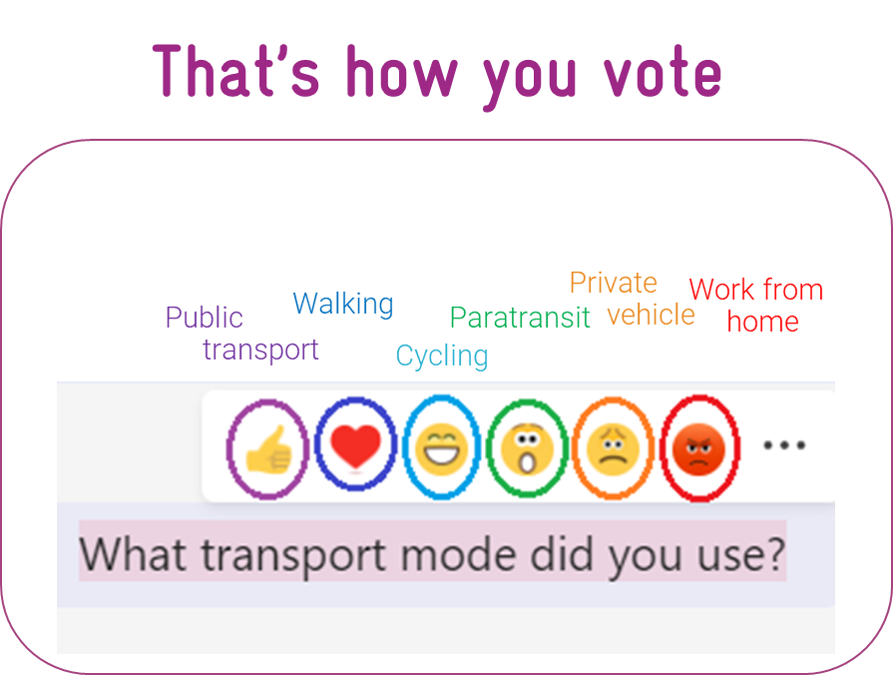




Expect for the vote to take about 2 minutes
Use 3 minutes to read the question, wait for answers and announce the results
Alternative Method:
Of course, you can use any voting tool of your choice here.
If you are doing this as an in person workshop, you can also invite participants to share their thoughts out loud.
Poll: What transport mode did you use to go to the office today?
  Public transport
  Walking
  Cycling
  Para/informal transit
  Private vehicle
  Working from home
You can also ask participants to elaborate on their choice in the chat
See how we conducted this exercise:
Data types and data collection methods for an urban mobility diagnosis - YouTube
Read out loud while assistant posts in the chat

Slide 13
Plan about 30 seconds on this slide
3
Urban Mobility Diagnosis
The context of sustainable mobility planning
Diagnosis with SUMP
The importance of collecting data in the planning process
Notes:
Introduce the section briefly touching upon sub-topics

Slide 14
Plan about 2 minutes on this slide
The Diagnosis with the SUMP
DIAGNOSIS
Analysis of strengths and weakness
ELABORATION OF THE VISION
Priorities
DETAILED SCENARIOS
Transport networks and mobility enhancement
SUMP ACTION PLAN
INCEPTION
Opportunities and threats to sustainable mobility
Orientations around the territory
Goals
Public policies
Framing the program of works
Engaging partners and stakeholders
Short, medium and long term action plan for sustainable mobility in Mebidangro

Slide 15
Plan about 2 minutes on this slide
The importance of the Diagnosis and Data Collection
Survey design
Pilot survey
Evaluation
The Diagnosis is based on factual observations backed by data
Diagnosis
Main data collection
Real time evaluation
The investigation on urban mobility challenges must be data-based
The more comprehensive and robust the data collection, the sharper the diagnosis
Salient points of the diagnosis will be the priorities to adress by the measures later
The setbacks must be formalized
Opportunity to compare and benchmark urban mobility in city against other cities (contextualization)
Provides clear painpoints to address
Provides data to model and quantify measures
Real time adjustments
Elaboration of the vision & goals
Data validation
Definition of measures to improve diagnosis
Data cleaning
Data redressing
Detailed Scenarios
Diagnosis

Slide 16
Plan about 1 minute on this slide
Data Collection: Mobility Survey Design
What are we trying to achieve?
Develop skills related to mobility survey design and implementation
Presentation of type of surveys and related issues
Methods involved and good practices

Slide 17
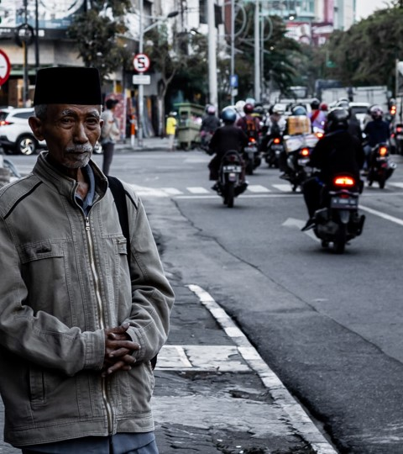
Plan about 30 seconds on this slide
4
Why Mobility Surveys?
Why Data?
Different Types of Data
Data Collection Process
credits: Hobi Industri, Unsplash

Slide 18
Plan about 1 minute 30 seconds on this slide
Why Data?
Without data, you can only make assumptions, generally biased by your personal background :
Impact on the accuracy of transport model and traffic forecast
Impact on the decision made concerning scenarios (infrastructure sizing)
Impact on the validity of socioeconomic and financial assessment
Data is a key element to transport project planning and assessment:
Proceed to the analysis of the current mobility situation
Participates in scenarios definition
Proceed to transport modelling and forecast for SUMP scenarios assessment
Notes:
Data collection is a huge task that requires a lot of resources, so before diving straight into it, it is recommended to take some time to assess the need and why we do it. This will save time for errors that might appear in the later stages of the process.
It is also important to settle and take some time to evaluate the analysis because without that, you can only make assumptions which would be biased
on the knowledge of the city. It may or may not be accurate or could have a great impact on the accuracy of the works later on. It could also impact decision-making on scenarios and socioeconomic and financial assessment.

Slide 19
Plan about 1 minute 30 seconds on this slide
Different Types of Data necessary to describe a Complex System
SOCIO-ECONOMIC CONDITIONS DATA
INSTITUTIONAL FRAMEWORK: Governance, Financial capacities
URBAN FABRIC AND LAND USE
TRANSPORT DEMAND
→ Traffic observed and Mobility patterns
TRANSPORT OFFER
→ Transport modes available and their characteristics
SECONDARY DATA
PRIMARY DATA
Notes:
Data could be divided into two main categories:
Secondary Data: This data focussing on instituional framework, urban fabric and land-use and socioeconomic conditions is mostly available at municipal or regional levels and is easily available in most cases and do not require extensive surveys
Primary Data: primary data mostly focussing on transport offer and transport offer is what we ought to collect for a SUMP process. Collecting the data on transport demand and transport offer helps identify gaps on why the current transport system needs improvement. To collect data on transport offer, retrieving information from municiple level could be one way because of licensing of operators and designated routes. However, it is always recommended to have a field observation on how these licenses and routes are operated in reality. For instance, in the case of informal transport in many countries, we can't assess the reality of the fleet size or the capacity of the vehicles through the official documentation, but what we want to see is the field conditions and for that surveys are always very valuable

Slide 20
Plan about 1 minute 30 seconds on this slide
Data Collection Process
PERFORM DATA AUDIT
CONSULT STAKEHOLDERS FOR THE COLLECTION OF EXISTING DATA
(institutional data, previous studies/surveys…)
RETRIEVE AVAILABLE DATA
Synthesize their content, identify data gaps
COLLECT ADDITIONAL DATA
To fill important gaps in data (Mobility survey with Field data collection):
  Update existing data
  Fill gaps in existing data
Notes:
Performing a data audit could be the first step to analysing what is there already and what is needed. A data audit is a key step to be conducted in a minimum time. Performing this step could help retrieve important datasets which could be updated with few steps and could save alot of time, resources and effort. Consultation with stakeholders on important factors such as institutional frameworks,socio-economic contexts and demographic data could also help support fill in the data gaps and function as secondary data.

Slide 21

Plan about 30 seconds on this slide
5
Types of Mobility Surveys
Household Survey
Traffic Count Surveys
Survey by Interviews
Travel Time Survey
Notes:
This section is basically about mobility surveys, as implemented, meaning what kind of
surveys do you want to conduct depending on the information you're trying to get

Slide 22
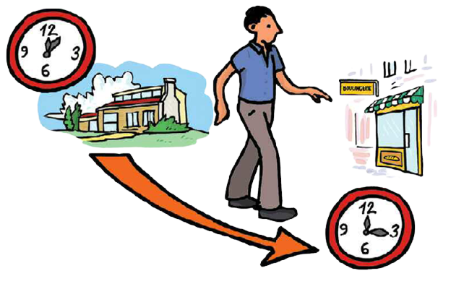
Plan about 1 minute on this slide
Mobility Surveys
A trip is defined by the answers to the following questions:
Why ?
Where ?
When ?
How ?
Trip purpose (work, school,leisure)
Origin and Destination
Time period and Travel
Transport mode, itinerary
Time
Optimal data
Periods of surveys, over months, weeks and hours
Composition
Space
Study area
Details on types of vehicles and characteristics
Notes:
Trips are always defined by why, where, when and how
The Why: we usually want to identify trip purposes and how the person is going to work, school or for leisure, as to identify the nature of the trip.
The Where: It can be answered with with origin and destination
The When: refer to the time period and travel time (which is important to differentiate between time of travel and time and departure)
How: refers to the mode used and the itinerary followed
Mobility surveys should allow to cover these different facets of time, space and even composition to have the optimal data

Slide 23
Plan about 1 minute on this slide
Household Survey
Different Types of Surveys for different purposes
Traffic Count Surveys
Classified Traffic Counts
Directional counts at junctions
Survey by Interviews
Public transport OD interviews
Roadside Interviews
Travel Time Survey
Notes:
There are four types of main data surveys or investigations that we elaborate on
Household surveys or household interviews
Traffic counts (classified traffic counts on longitudinal roads or directional accounts and junctions
Surveys by interviews (within public transport or in the roadside on the roadside for private vehicles)
Travel Time Surveys

Slide 24
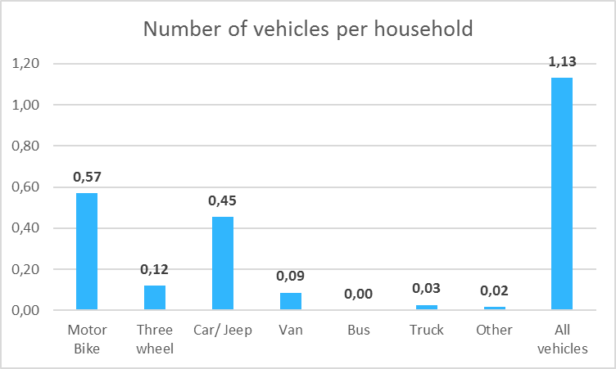
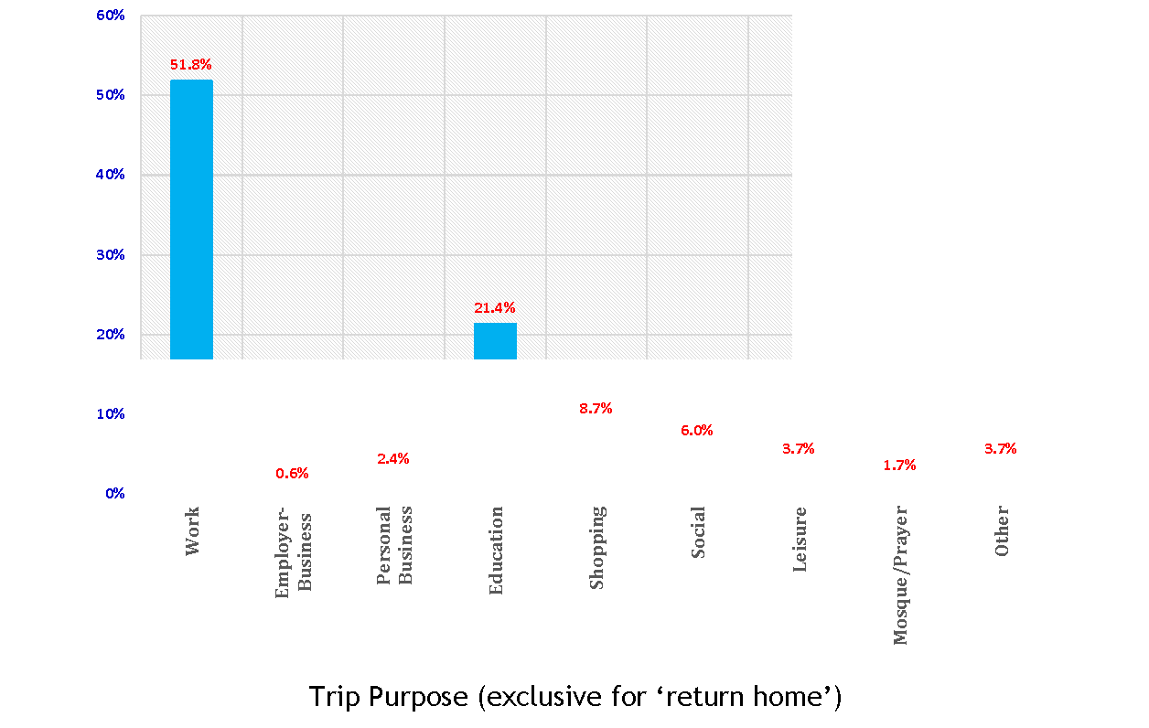
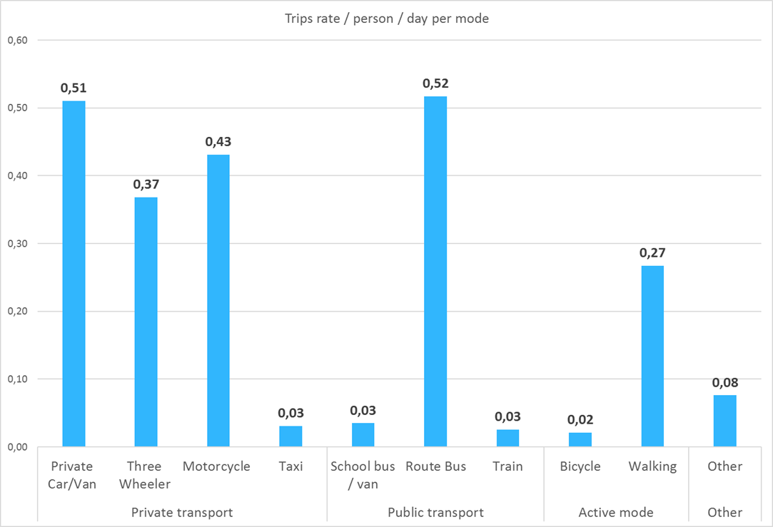
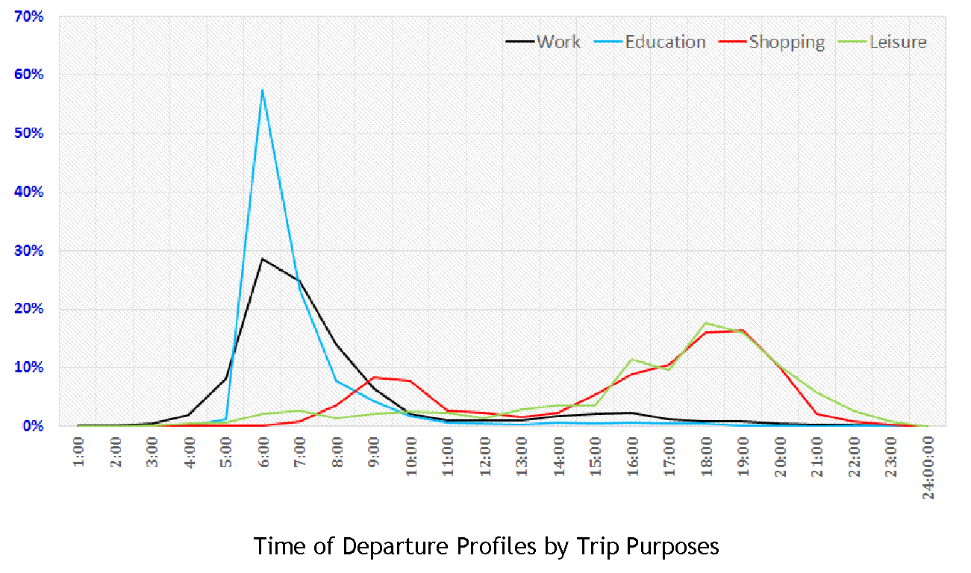
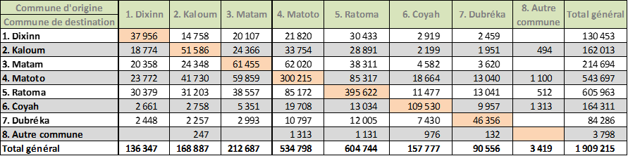
Plan about 2 minute on this slide
Household Survey
Purposes
Inventory of trips and mobility patterns on the study area
Provide a wide range of data: housing characteristics, household socioeconomic data, motorization, individual occupation, trips, mobility rates per mode/purpose, opinion about mobility and transport …
Used for decision support, modelling, transport planning and evaluation
Based on the relation between settlement/socioeconomic and mobility patterns
Notes:
This is the best case of investigation one could conduct. A household survey allows to describe or get mobility data from one household, meaning several members. It allows to assess probability patterns of these members and provides a wide range of data such as characteristics on social economic data, motorization, vehicle ownership, income, revenues, mobility rates and also their opinion and state and preference. We could use this data for very detailed decision-making and modelling.

Slide 25
Plan about 2 minute on this slide
Traffic Counts
What to count?
What to count?
Vehicles
Persons (riders)
Trips… for all transport modes, passengers and goods
At cross sections, at junctions
At peak hours, daily, weekly, permanently
Counts are generally exhaustives (all vehicles are counted), with possible classification of vehicles counts allow for :
Average annual trafic estimation
Hourly, daily, monthly traffic evolution
Redressment of OD interview surveys
The case of SUMP Mebidangro
MYC composition
Notes:
Traffic counts generally provide information on persons, vehicles and trips and provide information on volumns at certain location such as cross sections or certain times of the day (such as peak hours), instead of origin-destination. This type of survey could be conducted 24/7 depending on the resources available.
The counts are generally exhaustive; vehicles are counted to draw an average annual traffic estimation or an hourly, daily or monthly. This allows combining this data with previous survey data from a certain sample to estimate the actual volumes we observed on those trips. This is called extrapolation, which allows having a real picture of whole population movements without interviewing the whole population
The image on the left represents traffic counts per vehicle carried out in the case of Medan SUMP. why does it matter to have this differentiation of vehicles during the data collection? It allows later to have a final analysis on the estimation of greenhouse gases per type of vehicle based on the volumes since each vehicle has different emissions rates then we can have a final analysis

Slide 26
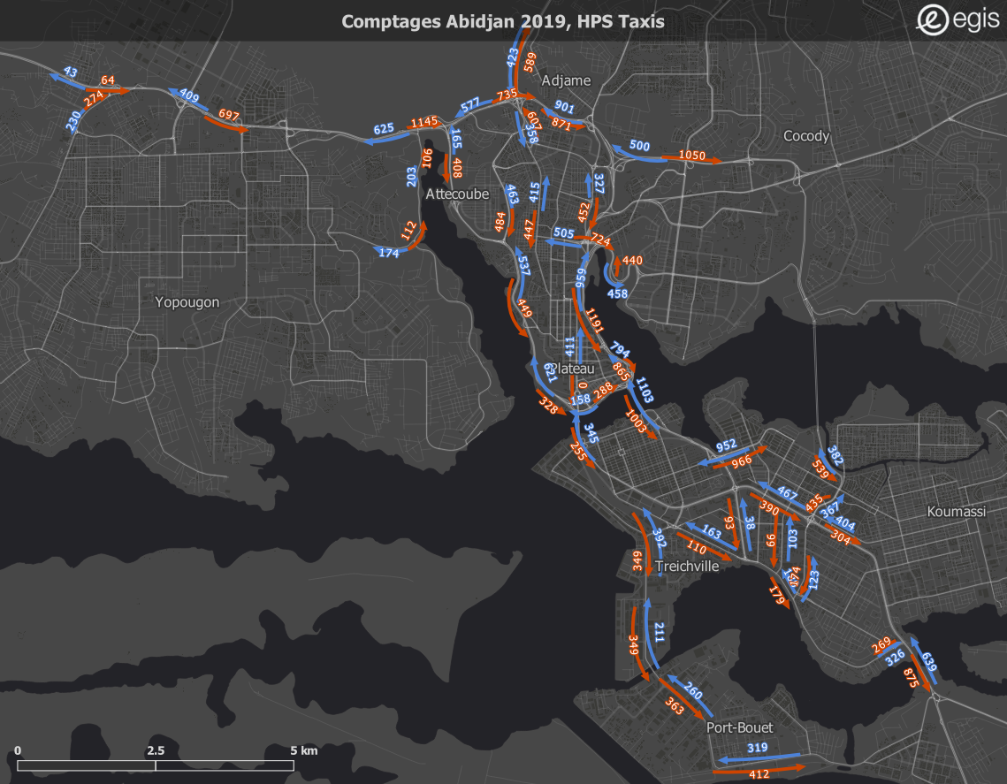
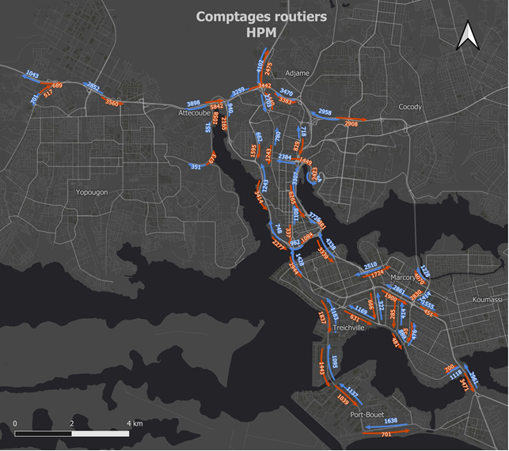
Plan about 1 minute on this slide
B. Traffic Counts Results Examples:
Link sections 1/2
Taxis traffic at evening peak hour
Average Annual Daily Traffic (AADT)
in Personal Car Unit (PCU)
Notes:
This is a quick illustration that represents traffic counts on main access. At busy hours, for example on the left, we have taxi traffic at evening peak hour and on the right average annual daily traffic (AADT) in a PC (personal car unit). We see that both of them are not exactly the same we may have more private vehicles used towards the southeast hinting at a certain demographic working there and going back home

Slide 27
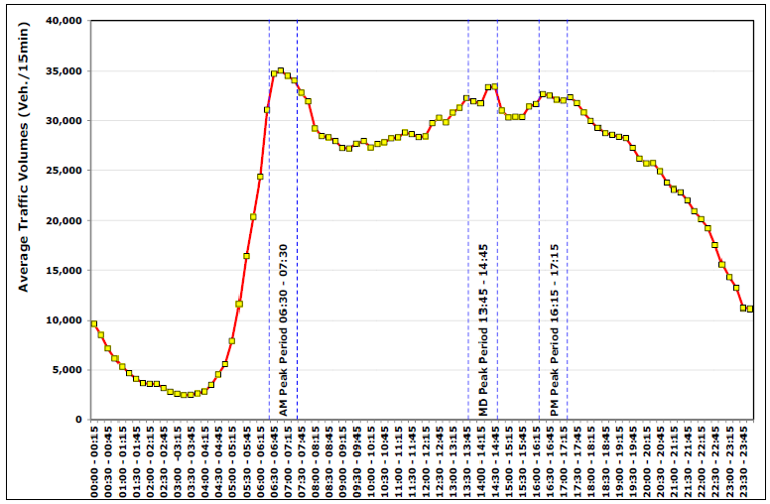
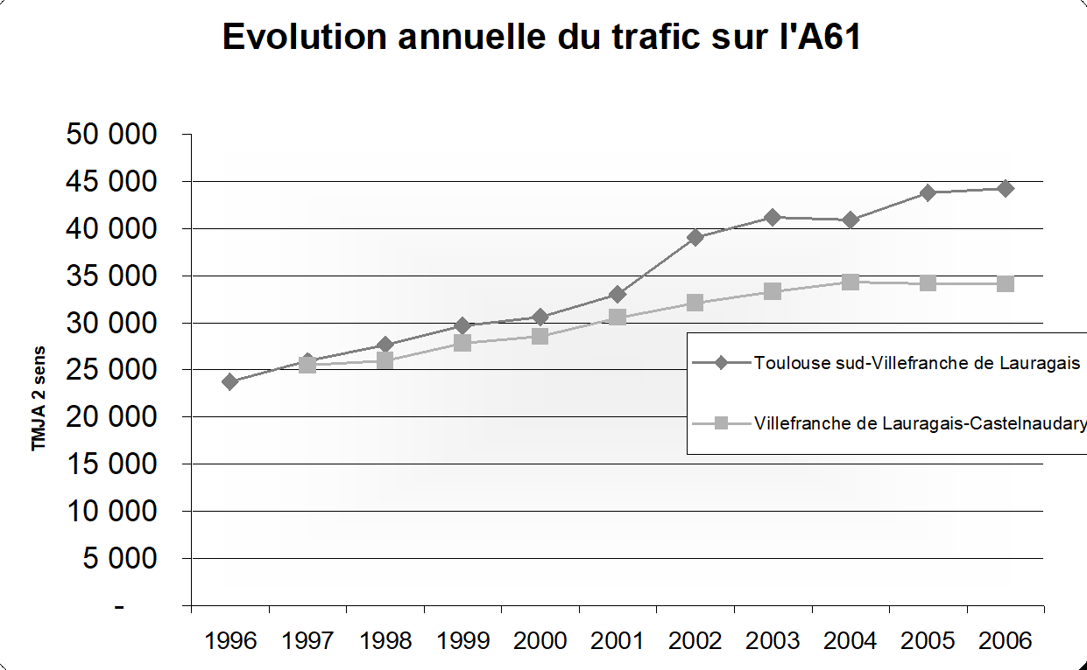
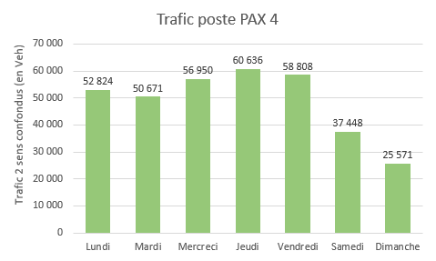
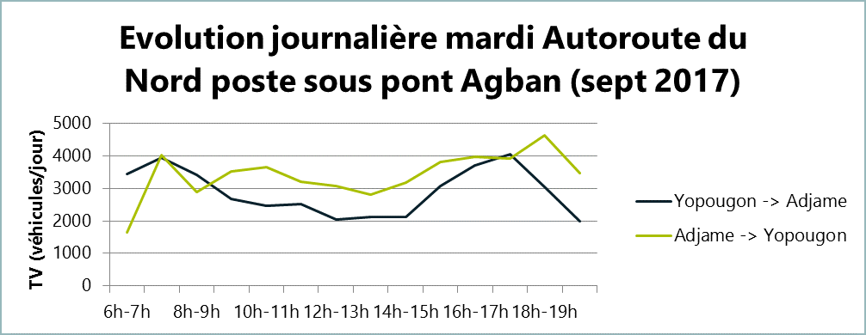
Plan about 1 minute on this slide
B. Traffic Counts Results Examples: Link sections 2/2
Hourly traffic for a typical weekday
Yearly evolution of traffic
Average daily traffic
Hourly traffic for a typical day (PCU)
Comparison for different links
Notes:
These are just illustrations to highlight a little bit of the principles said beforehand.
Hourly traffic for a typical day so we can have the curves or the volumes, and how they vary during the hours of the day.
We can identify peak hours for the morning or the evening; in some cases we could also identify hype peaks (those 15 minutes during a day in which it could be plus 30% or 40%)

Slide 28
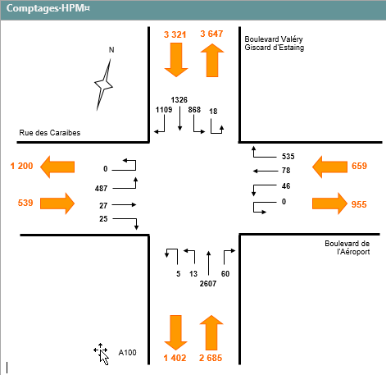
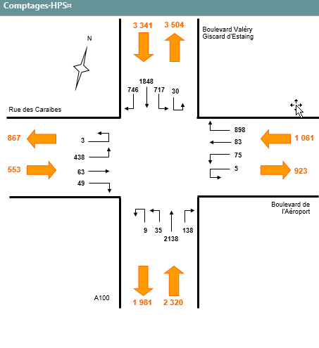
Plan about 1 minute on this slide
B. Traffic Counts Results Examples: Junctions
Movements per direction at junction (PCU)
Notes:
The illustration represents traffic hunting and junctions which are directional and can give hints or information on the saturation of junctions. It is useful to indicate whether implementing measures is viable such as traffic lights, roundabouts etc.

Slide 29
Plan about 2 minute on this slide
C. Survey by Interviews
Central element of traffic studies is the construction of the demand matrix, with origins and destinations.
Collect information about
Origin, destination, purpose, travel time, trip frequency
Vehicle type, vehicle occupancy (private transport)
Access and egress mode, transport cost (public transport)
Related to transport model
Roadside Interviews: Necessary to intercept/stop road traffic
Public transport surveys: Intercept public transport riders either on-board or at station
Notes:
These interviews are somewhat parallel to household interviews but are conducted outside or at fixed points such as rail stations, within vehicles or even road-side interviews. The goal of this type of interview is to have a realistic picture of movement/mobility and seize the passenger/traveller while they are on a journey. Most trips are not binomial (home-work-home) rather, they have other smaller stopovers such as shopping, school etc; therefore, this method relying on memory could provide more details. General information could include origin-destination information, travel purpose, time frequencies, vehicle type/occupancy etc.

Slide 30
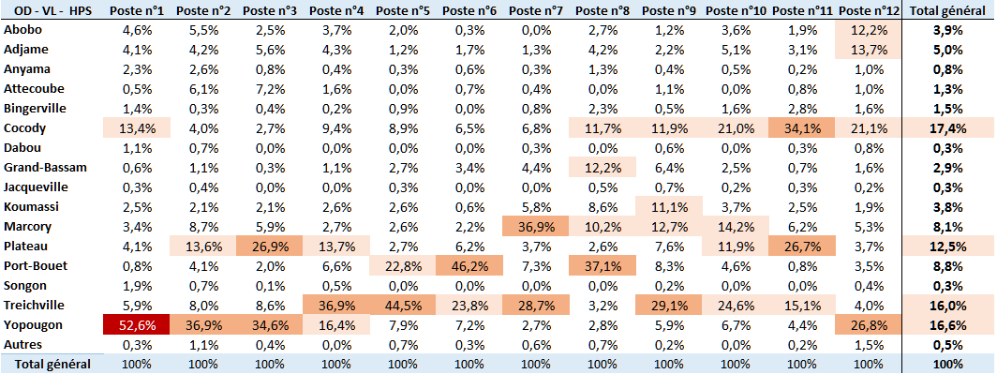
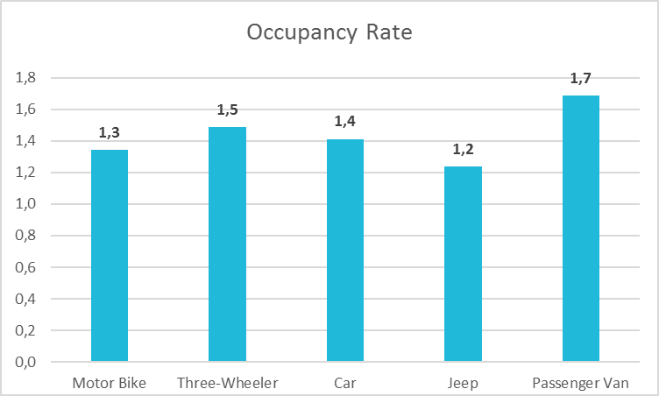
Plan about 1 minute on this slide
C. Survey by Interviews: Road-side Interviews Examples
Origin breakdown per interview location
Occupancy rate per type of vehicle
Notes:
Road-side interviess give a clear picture of where do the travellers come from (as illustrated in the figure on the left),It could help to breakdown the original interview location, occupancy rate per vehicle type such as motobikes, car. etc. In this type of survey, the finer the details one is observing (like occupany rates, type of vehicle), the finer the information gathered.

Slide 31
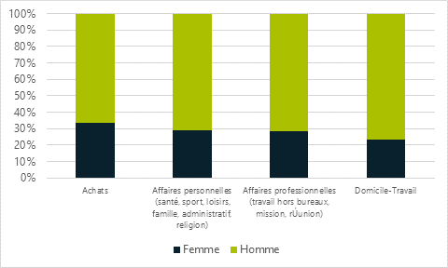
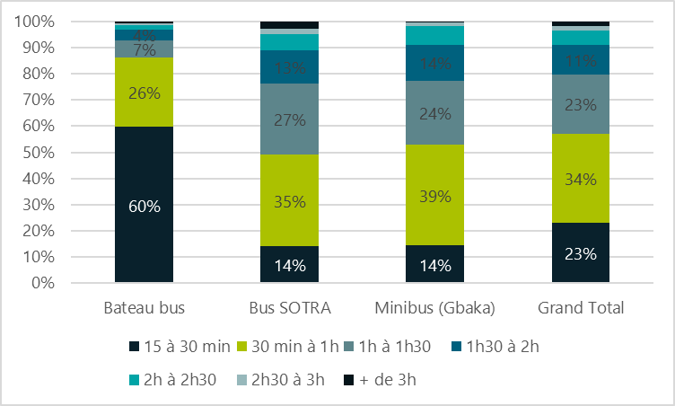
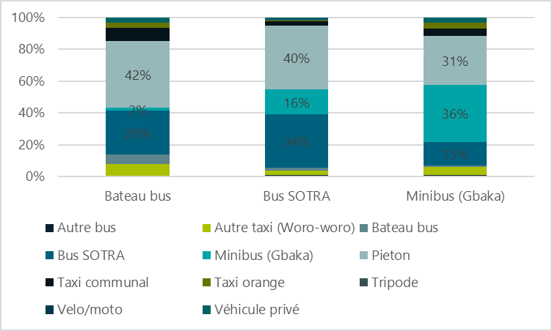
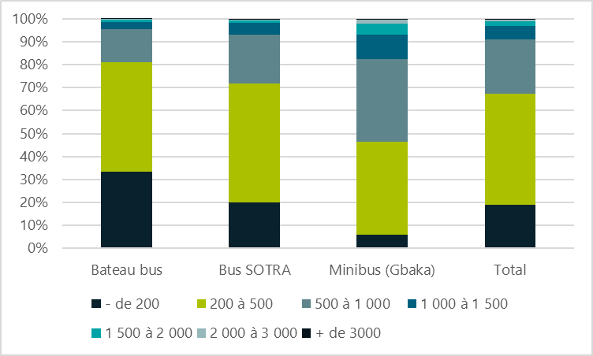

Plan about 1 minute on this slide
C. Survey by Interviews Results Examples: PT surveys
Trips breakdown per purpose depending on gender (women/men)
Average total travel time
Access and Egress modes
Trip cost
Notes:
Other parameters that could be gathered doing these types of survey in combination with trip purpose, trip cost and travel time is the gender. This is the best methodology to assess gender as interviews could be conducted on onboard vehicles assessing the participant response, what mode of transport was used previously and what would be used further.
Information on trip cost is hard to attain in developing countries generally. In the case of Medan, electronic means of payment are still absent and data tracking is very hard as most payment are done by cash. Therefore, this method could help fill data gaps.

Slide 32
Plan about 2 minute on this slide
D. Travel time Survey
Why perform travel time surveys ?
How to perform travel time surveys ?
Travel time is an important parameter for mode choice and itinerary choice (as well as travel cost – related to individual socio-economic parameters – and attractiveness)
Necessary to check a model calibration, not only for traffic loads, but also for its ability to restitute reliable travel times after traffic assignement
Potentiel travel time saving is part of transport project / policy assessment (value of time)
Floating car: on each itinerary surveyed, several measures per direction and time period
Use of big data :
  Usual sources : GPS, Google, mobile phone providers …
  Possible to retrieve real time data or historic data
  Sample quality ?

Slide 33
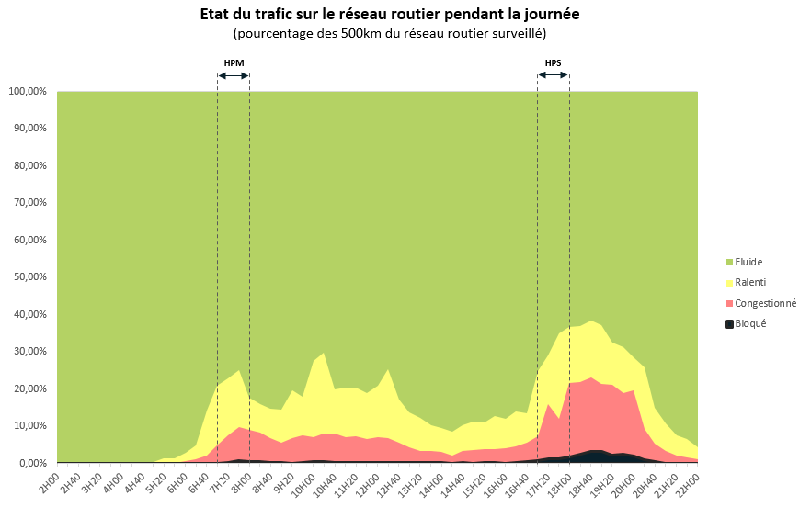
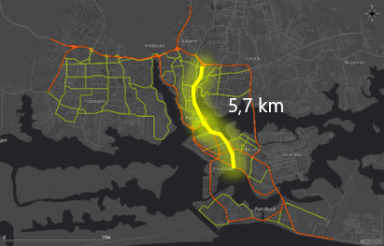
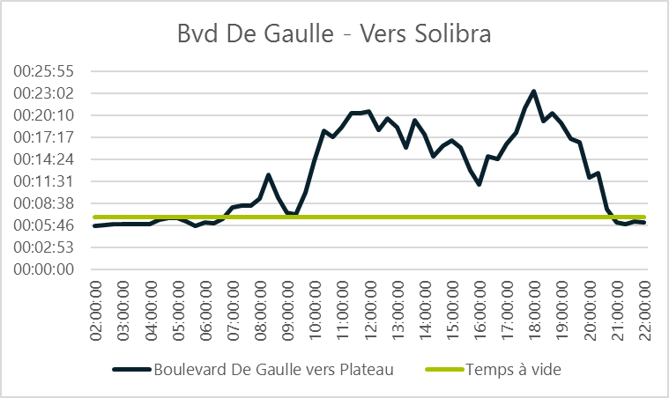
Plan about 1 minute on this slide
D. Travel time Surveys Results examples 1/2
Travel time on a designated itinerary
Notes:
The help identify the travel time per journey depending on the hour of the day, the congestion, geography etc.

Slide 34
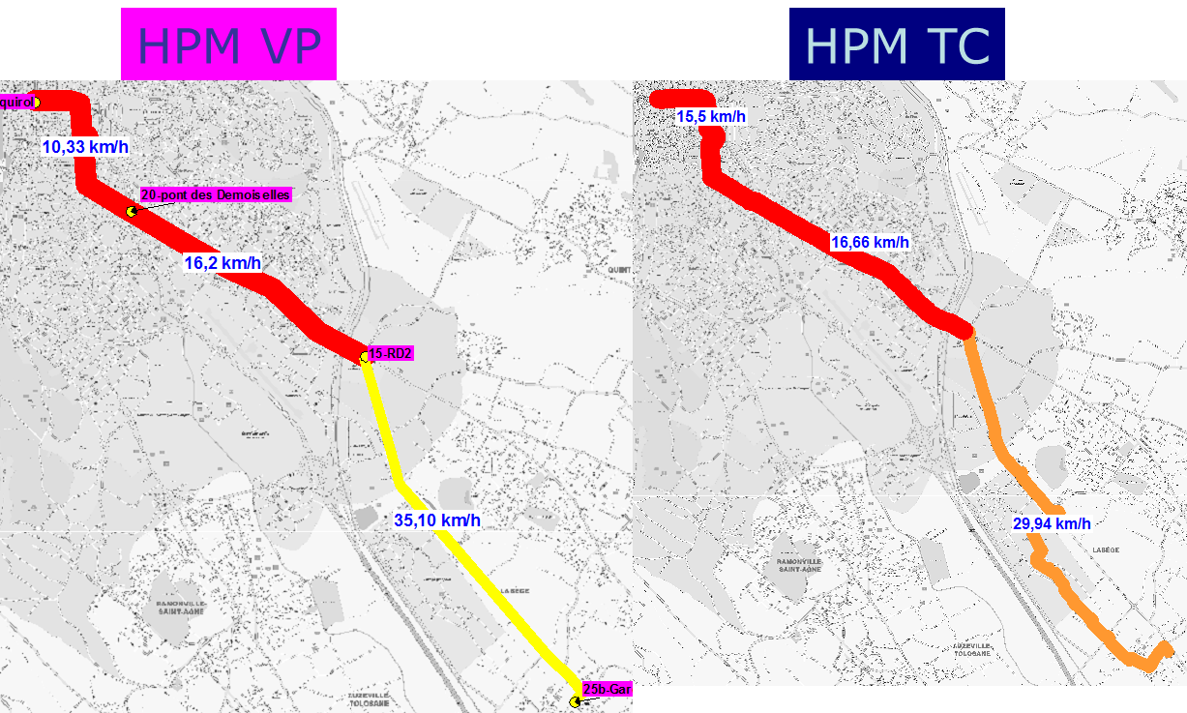
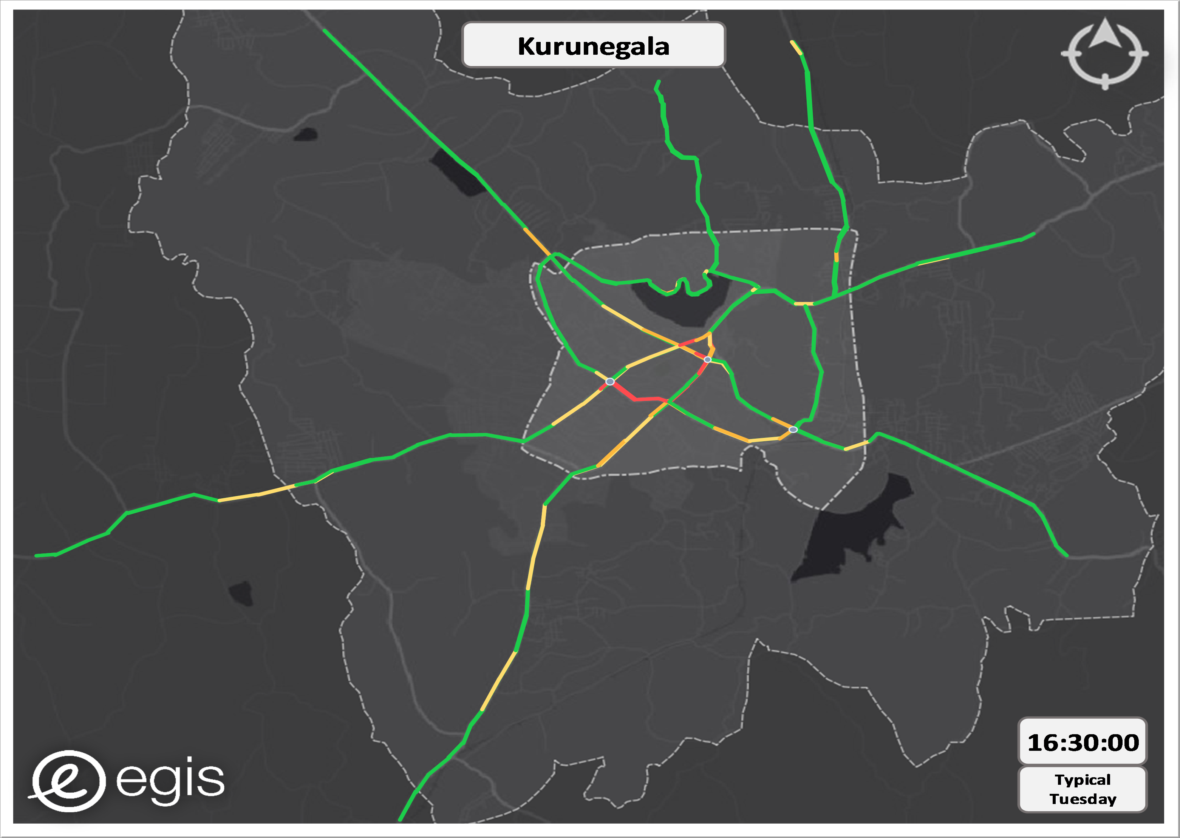
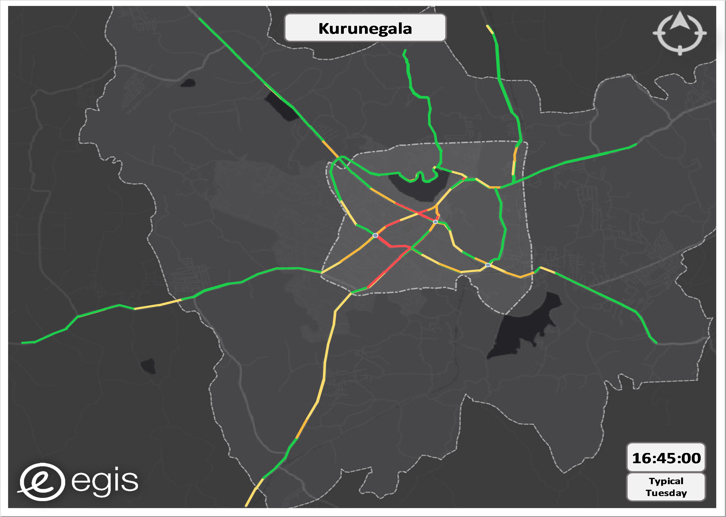
Plan about 1 minute on this slide
D. Travel time Surveys Results examples 2/2
Comparison for travel speed between private car and public transport
Representation of the road congestion through Google data
Notes:
The figures illustrate the comparison of travel time for public transport and private vehicles. On the left it is evident that public transport is actually slower in peak hours when compared to a private car. On the right is an example of Kurunegala, Srilanka where we see congestion analysis during peak hour in the evening.
The data illustrated is more realiable on points shown as red as it measures high congestion, but what is risky to use this data is on the actual green axis where congestion is indicated, but it might actually be because no congestion is measured there, meaning that the users using these axes do not use google data or google equipment or technologies and so on

Slide 35
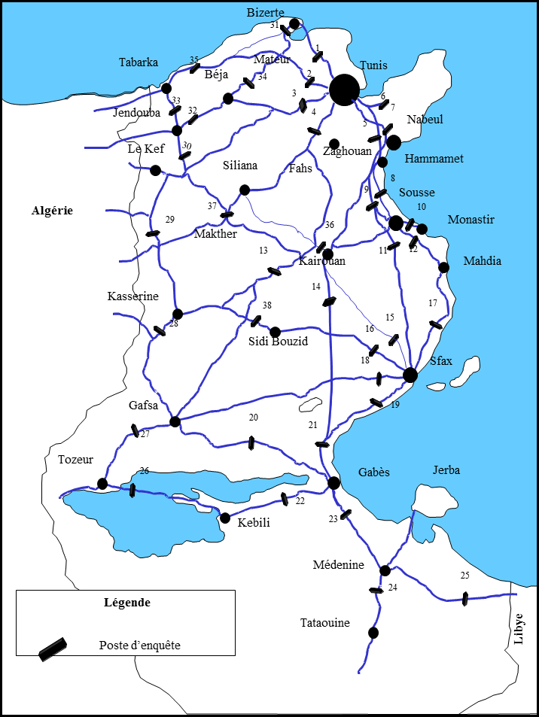
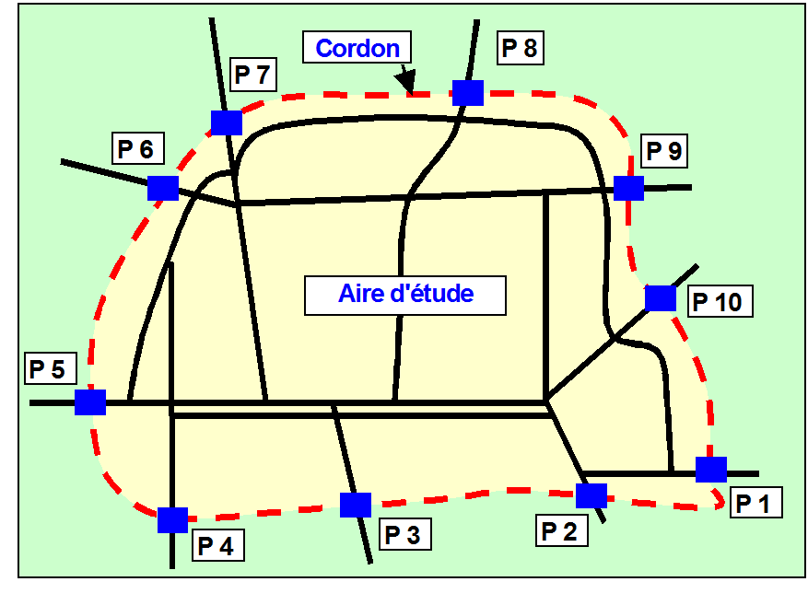
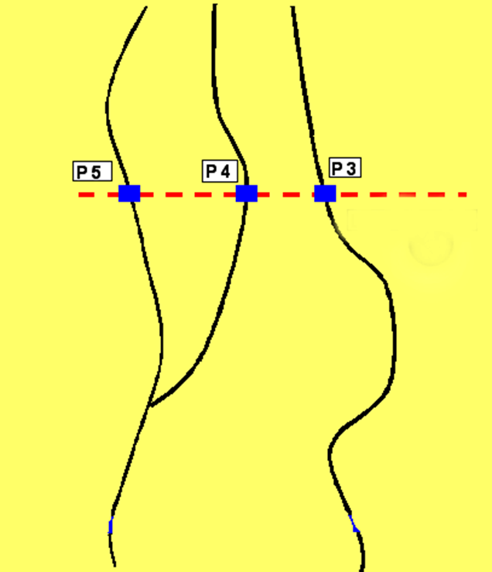
Plan about 2 minute on this slide
RSI and Screen lines
Complement
Stand-alone
Roadside Interviews can complement household surveys, as a screen line to intercept exchange and transit traffic (trips with the origin and/or destination not included in the HHS area)
Number of locations limited to main axes in/out of the area
All the possible relations are « cut » by the survey line
RSI + HHS allow to collect a much larger range of information
RSI can constitute also a stand-alone data collection (possible to build a full demand matrix only from RSI).
Requires a large survey plan to cover all main road links all over the study area → Necessary to be able to catch all significant OD
Can be complex to organise : multiple location to handle simultaneously, police support, interviews over different days, redressment of the interviews

Slide 36

Plan about 30 seconds on this slide
6
Methods of Data Collection
Household Survey
Traffic Count Surveys
Survey by Interviews
credits: mostafa meraji, Unsplash

Slide 37
Plan about 2 minute on this slide
Steps for survey plan design and implementation
1
Define survey area in relation with study area
2
Define survey plan depending on the project goal, existing data, available time & budget
3
Prepare forms for each type of survey
4
Set up the logistic for the survey campaign : communication, authorizations, equipment, …
5
Hire and train surveyors
6
Implement a pilot survey
7
Implement the main survey, with adequate monitoring
8
Clean / control / process the data collected
Notes:
Here we list the steps to design a survey plan and program the implementation of the survey plan.

Slide 38
Plan about 2 minute on this slide
Household Survey Methodology
Implementation:
Questionaires:
Ways of implementing a HHS:
Face to face interview
Telephone interview
Internet
Pro / cons of each method
Household survey form composed generally of 4 different forms:
Household form: 1 form per household
Individual form: 1 form per household member
Trip form: 1 form per household member surveyed for trips (4 member max. per household)
Opinion form: 1 form per household member surveyed for trips (4 member max. per household)
Notes:
This slide represents the methodology for conducting a household survey and what kind of data could be retrieved.
Overall 4 types of survey forms could be used to conducte a household survey: household form, individual form, trip form and opinion form
Three types of survey methods could be used to conduct a household survey: face-to-face, telephones and internet.
Pros and Cons of each method:
Face-to-face: It is the best survey type which provide high quality data with validity. This survey could include a wider population, could have a random sampling and could be conducted by explainign questions and getting adequate answers.
Telephone: It is ofcourse better than internet surveys yet, but sometimes accessing data (such as phone numbers) could be challenging and costly to obtain. Similarly you could only have access to part of the population and limit your sample size to those with availability of cellular services.
Internet: It is the easiet to implement but it is only sometimes the best quality with more diversity. Since in this case, only digitally accessed individuals could form part of the survey. It generally has a low return-rate and even if you have returns, individuals check boxes quickly and validity of data is questionable.

Slide 39
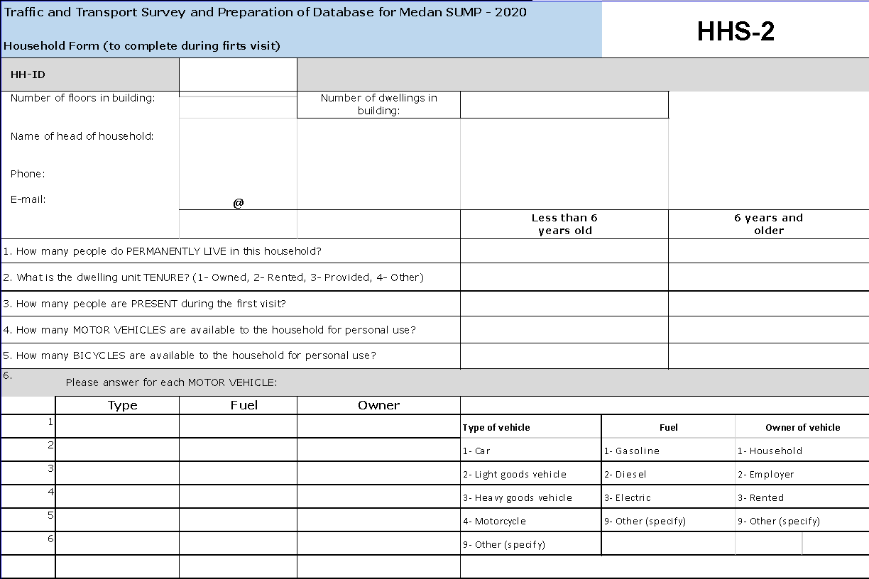
Plan about 1 minute on this slide
Household Survey
Methodology:
1. Household Form
Housing information
Household size
Household motorization
Household income
Notes:
For household income, inquiring about an individuals monthly income could be sensitive/condidential data therefore, asking for the entire household could be easier which could indicate the average income per person and also give infromation on the socio-economic status of the survey area.

Slide 40
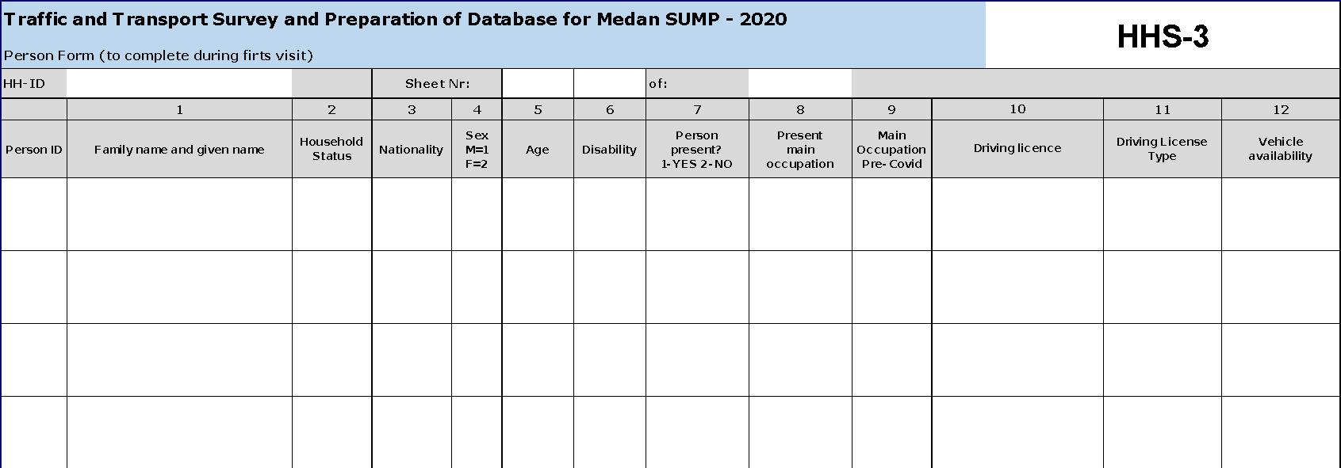
Plan about 1 minute on this slide
Household Survey
Methodology:
2. Individual Form
Detailed household composition
Individual characteristics
Main occupation
Vehicle availability
Notes:
It is important to have this individual trip form per household individual because it could vary significaltly between two different members of the same households. For example working class parents mobility patterns could vary from children, seniors etc. Each individuals will reflect part of the overall population that is different.

Slide 41
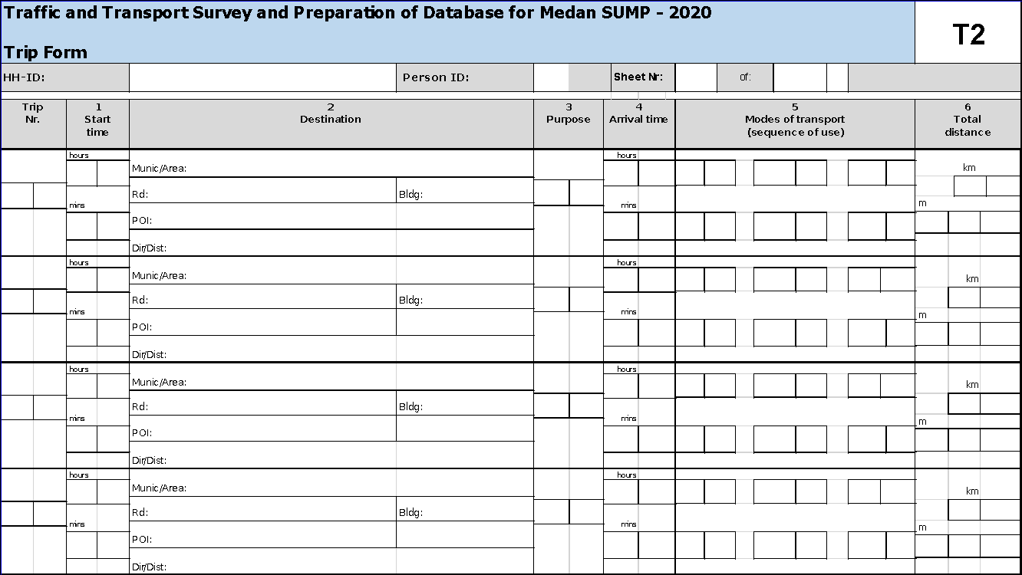
Plan about 1 minute on this slide
Household Survey
Methodology:
3. Trip Form
Collect all trips during a designated day (day prior to the survey)
Trip form organized as a global « round-trip » For each trip :
Destination (taking into account that the starting point of the day is home)
Purpose
Transport mode
Notes:
It collects trip information to constitute the origin-destination matrix. This survey usually collects information on the trip made on the previous day or the usual everyday routine. For each trip we ough to collect, the starting points, destination, purpose of the trip, and transport mode. To have a deeper analysis, one could inquire about startig time, arrival time and trip.
Round-trips include secondary and tertiary trips i.e. instead of from work-home trips such as shopping, gym, grocery etc. We want to have a full global round-trip to analyse the picture better otherwise the results would be too simple, to understand the difference of movements

Slide 42
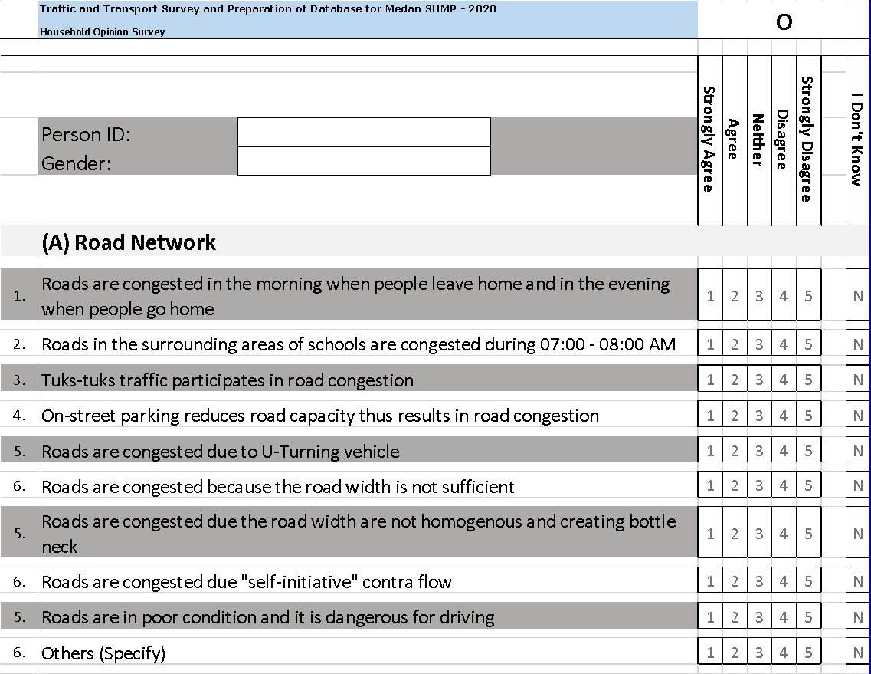
Plan about 1 minute on this slide
Household Survey
Methodology:
4. Opinion Form/Miscellaneous
Mobility needs
Opinion about transport offer quality, safety, possible improvements …
  Analysis by gender
  Possibility to shift to stated preference survey
Notes:
This survey mostly focusses on keywords such as agree, disagree, neutral or I dont know to collect information on user‘s opinions on key mobility questions.

Slide 43
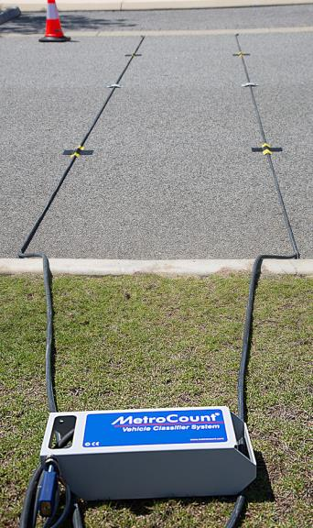
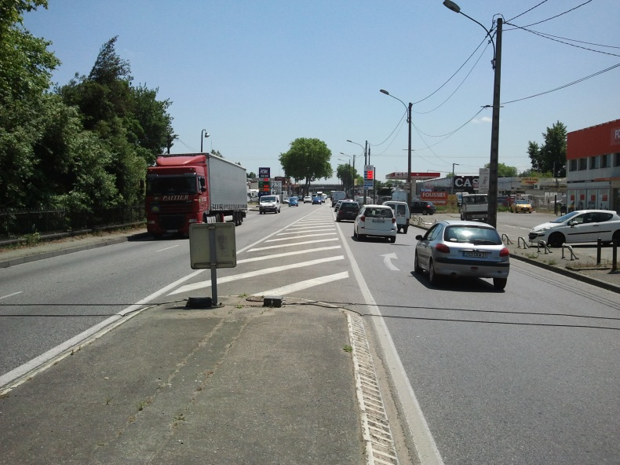
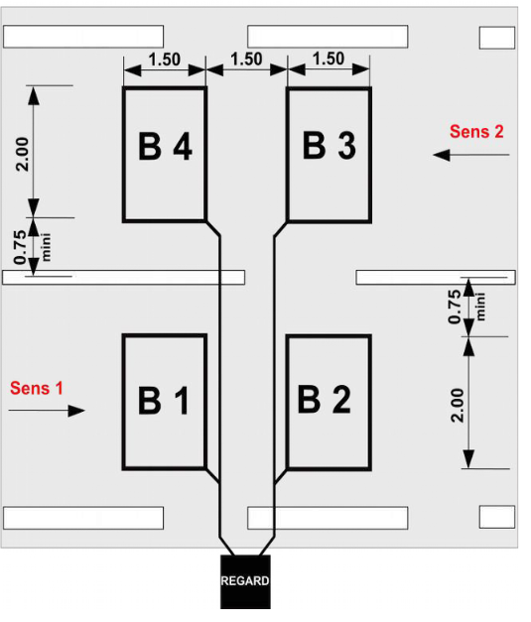
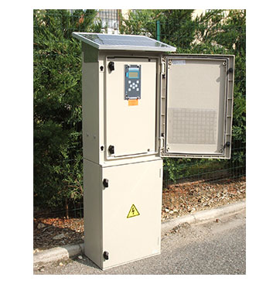
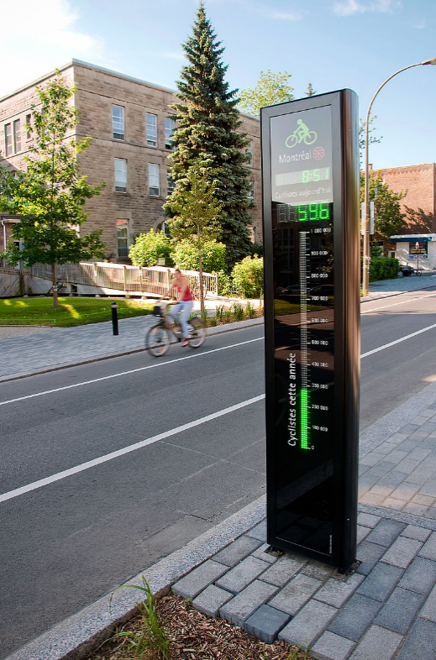
Plan about 2 minute on this slide
Different Methods for Link Section Counts
Method | Vehicle classification | Implementation | Data management | Time period | Data accuracy | Cost
Manually (surveyors) | ●●●●○ All types possible | ●●●●○ Depend on the survey plan | ●●●○○ Data entry, control, cleansing | ●●●○○ Day time only on short time period | ●●●●○ Higher details possible Possible humain error | ●●●●●
Temporary pneumatic tubes | ●●○○○ Light/heavy vehicles only | ●●●●○ Depend on the survey plan | ●●●●● Automatic processing | ●●●●○ Large time period possible Security issue at night | ●●●○○ Reliability of tubes can cause data loss | ●●●●○
Cameras, drones | ●●●●● All types possible | ●●●○○ Subject to local regulation | ●●●○○ Depends on video processing (manual/auto) | ●●●○○ Day time only on short time period | ●●●●○ Good if automatic processing | ●●●○○
Specific automatic devices for pedestrians and cycles | ●● ○○○ Specific to NMT | ●●○○○ Heavy (generally permanent + calibration) | ●●●●● Automatic processing | ●●●●○ Large time period possible Security issue at night | ●●●●● Good | ●●○○○ Higher if permanent
Permanent counting stations | ●●○○○ Light/heavy vehicles only | ●●○○○ Heavy | ●●●●● Automatic processing | ●●●●● Permanent | ●●●●● Good | ●○○○○
Pneumatic tubes
Magnetic loop
Permanent counting station
Cycle counting station
Notes:
This slide indicates different methods one could use to conduct traffic counts on longitudinal or straight roads (excluding intersections)

Slide 44
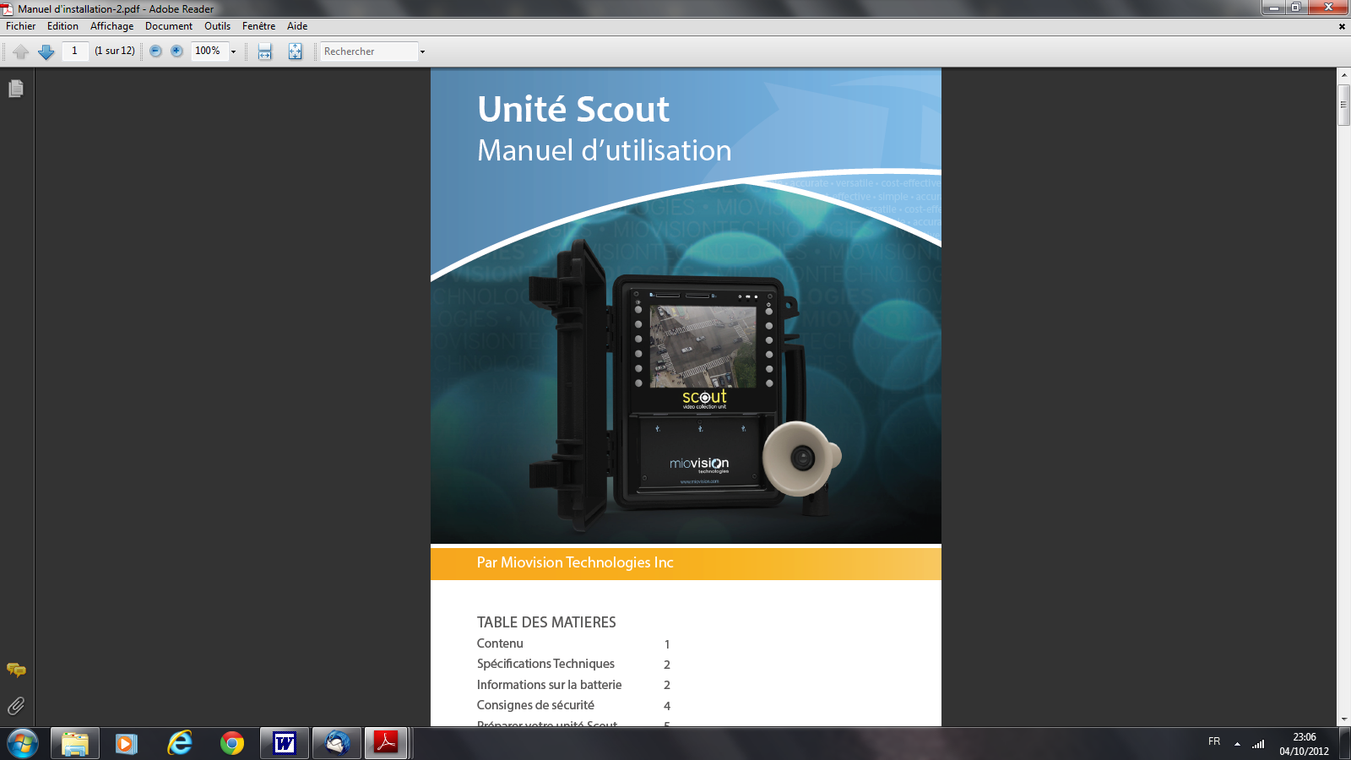
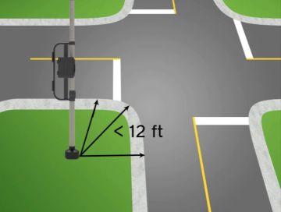
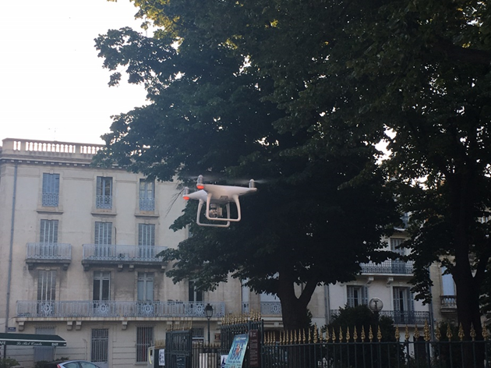
Plan about 1 minute on this slide
Different methods for junctions counts
Manually (surveyors)
Automatic counts
Direct count of movement
Recording of plates (tape recorder or video) and processing of the data
  Video cameras with a software enable to read plates
  Drones with software following vehicles in the junction
Scout camera
Drones

Slide 45
Plan about 2 minute on this slide
O-D Interviews Methodology
Different methods for private vehicles OD surveys
Methods for Public Transport
surveys
Driver interview
Plate reading (only possible for screen line OD)
Flyers (only possible for screen line OD): a flyer is distributed at each entry of the perimeter with a color code and collected at the exit
GPS / phone data
Interviews at stations
Interviews on-board
Online surveys
GPS / phone data

Slide 46
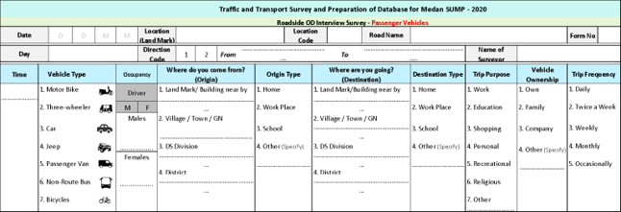
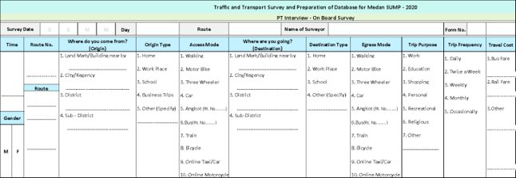
Plan about 1 minute on this slide
O-D Interviews
Methodology
Interview Forms
Necessary to be quick (especially for RSI and onboard PT surveys)
Trip informations : origin, destination, purpose, frequency
For road interviews : vehicle type and occupancy
For public transport : route identification, access/egress mode, cost

Slide 47
Plan about 1 minute on this slide
O-D Interviews Methodology
All interview survey data need to be redressed on the total traffic
Necessary to be quick (especially for RSI and onboard PT surveys)
The OD matrix from the interviews is expanded to fit the traffic counted
Generally, redressment per vehicle type and time period.
  Need to redress together only vehicles with similar patterns (for instance, impossible to redress light and heavy vehicles together)
Necessitates traffic counts per vehicle types accordingly
Need to have minimal number of surveys per group to redress (30 surveys per group minimum, 50 surveys preferably) to ensure statistical significance
  Better to have larger time periods to allow for bigger survey groups. The objective is to have redressment coefficients close one to another
Estimation of AADT shall take into account traffic seasonality

Slide 48



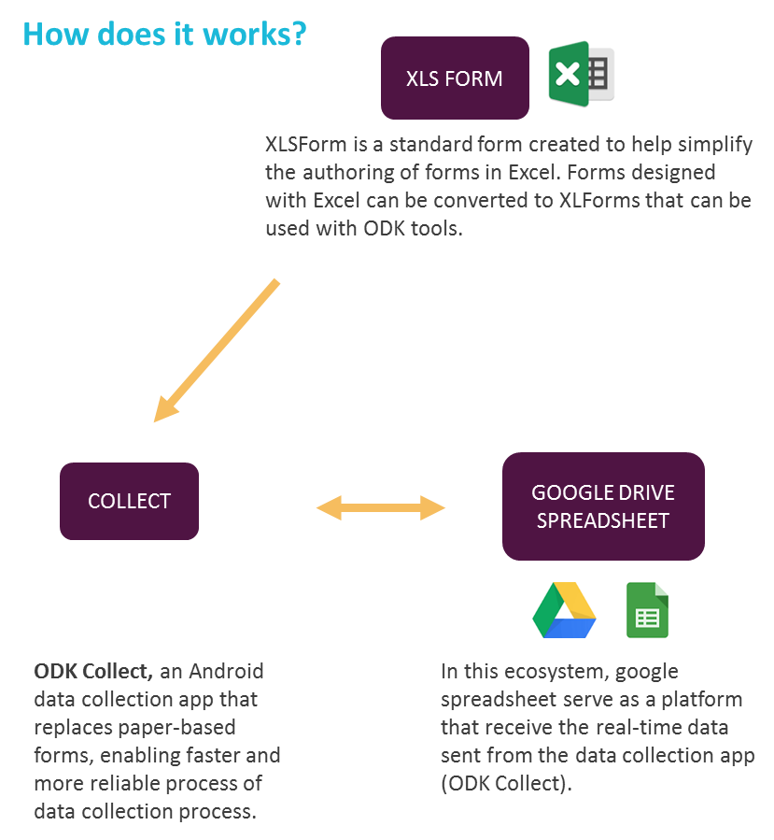



Plan about 1 minute on this slide
Data Entry:
Open Data Kit
Benefits on data collection
EASY TO MONITOR
Number of surveys (total, per surveyor, per day & time)
Eliminate hand writing process;
Eliminate printed material & printing cost;
Minimizing planning variation risk;
Eliminate mixed – up document risk.
Decrease chances of fraud (geolocalization of sample).
STANDARDIZED DATA
Standardized data, exportable to csv and kml
All interview survey data need to be redressed on the total traffic
REAL-TIME RESULT
Customizable data visualization tools (charts, word clouds, numbers)
TIME SAVING
Minimize time for data recapitulation and cleaning as the result of the survey is automatically digitized
Benefits on data entry
Eliminate data input process, that can save 3.000 – 6.000 working hours (373 – 745 working days) *normal working hour is 8 hour/day
Increased performance monitoring with standby operator on dashboard.
Decrease chances of fraud (geolocalization of sample).
Increase quality of data (readability, etc.)
MAP VISUALIZATION
Geolocated surveys or tracking routes
COST EFFECTIVE
Minimizing budget for the overall survey as
reduce the time for data recapitulation.

Slide 49
Plan about 2 minute on this slide
1. TRAFFIC VOLUME
2. TRAFFIC COMPOSITION
3. TRAFFIC VOLUME VARIATION
Data Collection Guidelines PM 96/2015
AADT: Annual Average Daily Traffic
Collected every month (preferable), or at least collected 4 times in a year.
Survey duration is 1-full-week (preferable), or at least 2 days (minimum)
15-minute survey interval
Traffic categorized by its axle type and its weight for pavement analysis and evaluation.
Traffic categorized as Motorcycle, Light Vehicle, Heavy Vehicle, and NMT for road capacity analysis & evaluation.
Understanding volume variation:
within a day (AM & PM peaks, off-peak)
within a week (weekday and weekend pattern)
within a month
within a year (seasonal traffic pattern)
Data collection requirement in order to plan, manage and optimize the safety, mobility, and effectivity of traffic according to Ministry of Transportation guidelines for Traffic measures.
Need to be standardized and adopted nationally
Related infrastructure, budgets, training to be dispatched
Direct influence on projects and plannings weighted for optimized guidelines
4. DIRECTIONAL TRAFFIC PROPORTION
5. SPEED AND DELAY
6. ROAD INVENTORY
Balanced and unbalanced directional traffic on road segments
Directional traffic proportion on junctions
CTMC (Classified Turning Movement Counting)
Spot Speed: Time mean speed, space mean speed
Travel Speed
Free Flow Speed
Traffic delay, geometric delay
Traffic light
Sign and road marking
Road lighting
Road safety equipment: delineator, guard rail, mirror, island, etc.
Bus stop, bus lane, parking area, intermodal facility
Curb, pedestrian sidewalk, bike lane, access for the disabled

Slide 50
Plan about 2 minute on this slide
TYPE OF RISK | EXAMPLE OF RISK | MITIGATION
Environmental | Bad weather conditions | Reactivity to postpone/delay part of the survey
Covid-19 pandemic | HHS non respondent Lower traffic at counts Modification of mobility patterns | Surveyors training Sanitary measures for surveyors Communication prior to survey Use historic data (previous surveys, phone or operator data)
Survey execution | Surveyors security (especially during RSI) Ability to stop traffic at RSI location Entry data app breakdown | Surveyors training Security equipment Collaboration with police Back up plan with paper forms
Reliability of data | Bad entry of data Non respect of methodology | Surveyors training Monitoring during surveys Automatic checks during data entry Adaptation of survey methodology
Accuracy of data | Inconsistency in data classification between counts and interviews | Quality checks during survey design
Data management | Different data format Risk of data loss | Use of international format (GTFS) Online storage
Risk to
Data Collection

Slide 51

Plan about 20 minute on this slide
7
Exercise
You refer to the exercise or presenter agenda to get more insights on the breakout group session

Slide 52

Plan about 2-3 minute to discuss the answers with the participants per task
Exercise: Survey Area
The definition of the survey area is related to the scale of the project, from a specific road project, to a metropolitan / regional transport masterplan. For a mobility plan like SUMP, the survey area:
Shall cover all trips impacting the SUMP perimeter (internal, exchange, transit)
Shall be declined for the different types of survey (different types of survey addressing different types of trips)
Shall consider future urban development
Example of Medan
Zoning
This is the answer to the breakout group tasks conducted in the case of Medan. You could develop a similar slide for your session
Household survey zoning refers to the sample building:
Survey area correspond usually to the inner perimeter of the study
Zoning of the survey area into drawing sectors :
  Homogeneous zones in terms of urban characteristics and density
  Maximum 30 000 inhabitants per sector
Random selection of household in each sector :
  At least 75 households/sector to ensure statistical reliability
  How to ensure a random draw ?
Notes:
This slide shows the answer for Task 1: Define survey areas of a SUMP in Medan. You could also develop a slide like this in the end of the breakout session and discuss the result with the participants.

Slide 53

Introduce this section briefly
8
Questions, Feedback and Farewell?

Slide 54




Spend about 3-4 minutes on this slide (if time allows)
Alternative Method:
Open up the microphone for any participant willing to ask a question, comment on the presentation or share their own experience.
If there is not enough time to go over all the questions, ask participants to send them on the chat or by email and tell them that they will be answered later.
Q&A
Chat
Speak
Post your questions in the chat and we will include them in the Q&A
Select “Show reactions” in the meeting controls, and then choose “Raise your hand”. Everyone in the meeting will see that you've got your hand up.
Go through the questions sent on the chat and filter by those that have not been answered and cluster them by topic.
The moderator should filter the questions and give the floor to the most suitable speaker to answer
Remember to thank participants and the guest speakers for their contributions, insights, comments and questions
Notes:
Remember to thank the participants for the session, their contributions and insights.
Thank the guest speakers for their experience and sharing their own experience.
Types of questions you could receive:

Slide 55




Plan about 1 minute on this slide
Stay tuned with MobiliseYourCity updates
Eager for more? subscribe to the MobiliseYourCity newsletter to stay updated with the latest information on our upcoming Mastering Mobility Sessions!
Register here or scan the QR Code
Please ask the participants to subscribe to our newsletter if they liked the content of our training material and want to stay updated for further sessions:
Share this link in the chat: Register here
Also, please promote our knowledge platform amongst participants for accessing latest publications.
Share the link in the chat:
Knowledge Platform
Missed previous past sessions? The recordings are available on their Knowledge Platform!
Visit Knowledge Platform here or scan the QR Code
Notes:
Please ask the participants to subscribe to our newsletter if they liked the content of our training material and want to stay updated for further sessions. Share this link in the chat: Register here
Also, please promote our knowledge platform amongst participants for accessing latest publications. Share the link in the chat: Knowledge Platform

Slide 56
Thank you for your attention
Keep in touch
Mobiliseyourcity.net
contact@mobiliseyourcity.net
@MobiliseCity
MobiliseYourCity
MobiliseYourCity

