Slide 1
The MobiliseYourCity Partnership
An introduction
31 March 2022
Name of the speaker

Slide 2
Introduction to the Partnership
Sustainable urban mobility planning and recent achievements

Slide 3
1
Introduction to the
Partnership

Slide 4
An impactful partnership between the EU, France and Germany, established at COP21
Donors:
Implementing Partners:
MoU Partner
Knowledge and Network Partners:
Part of:

Slide 5
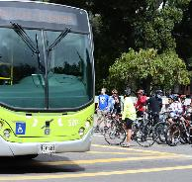
MobiliseYourCity’s guiding principles
Our objectives
1
2
Our vision
We work together as partners to shape low-carbon mobility systems that contribute to efficient, safe, and just cities for all urban residents of today and the future.
Our mission
Our mission is to incubate solutions, accelerate the adoption of proven approaches, and facilitate complex change processes to transform urban mobility
Accelerate the green and just transition to sustainable urban mobility
Facilitate access to sustainable innovative finance for large- and small-scale mobility projects
Foster more comprehensive, integrated and participatory urban mobility planning
Close the investment gap for sustainable mobility

Slide 6
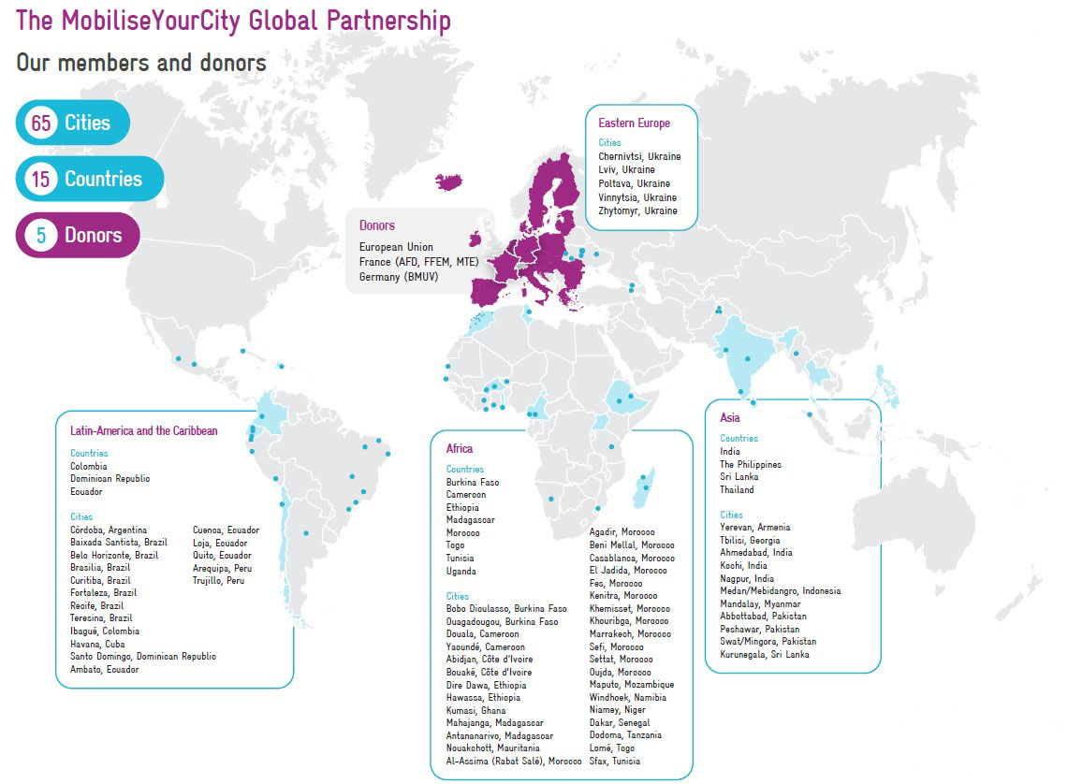

Slide 7
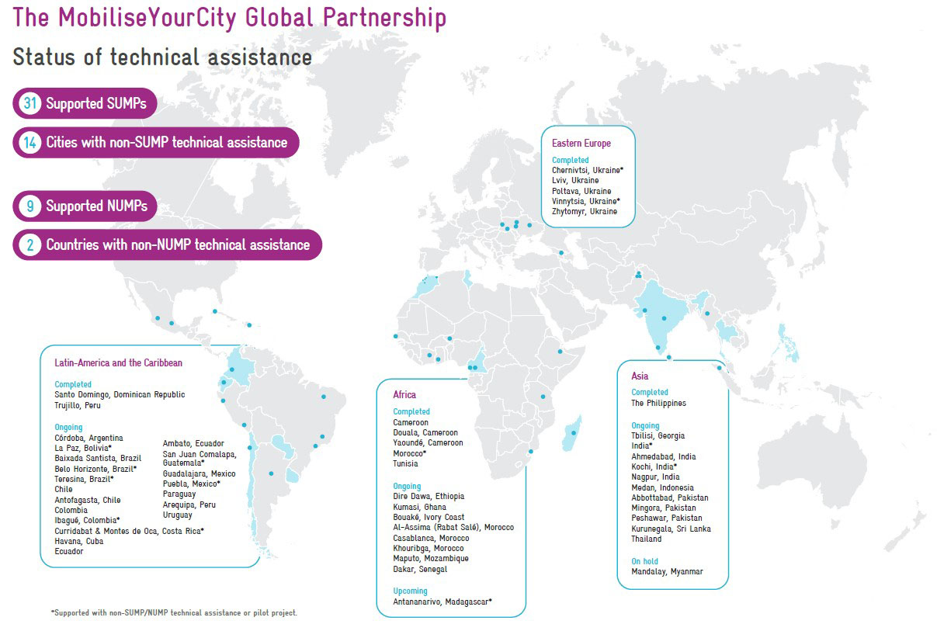

Slide 8
MobiliseYourCity’s service areas
1
2
3
4
New
MOBILITY PLANNING
Supporting implementation and investment ready plans for inclusive and low-carbon transport
CAPACITY BUILDING
Equipping practitioners with tested and scalable solutions
ADVOCACY
Encouraging institutions and individuals to embrace and resource sustainable mobility
IMPLEMENTATION SUPPORT
Empowering members to bridge planning with implementation for green and just cities
Supporting member cities in preparing city-level sustainable mobility plans and project preparation
Supporting member countries in preparing country-level urban mobility policies and investment programs
Deploying digital technology to improve mobility planning
Developing tailored methodologies and tools for our focus areas
Scaling our training offer to mobility professionals through strategic partnerships
Enhancing our digital platform for trainings, exchange and knowledge dissemination
Communicating local results to influence the global agenda
Engaging new partners and members to animate ambitious action
Empowering local behavioural change through evidence-based messaging
Piloting small-scale innovative finance to support walking and cycling
Professionalizing and formalizing jobs in the paratransit sector, in particular by building on digital technologies
Supporting institutional and regulatory reforms to enable implementation

Slide 9
2
Sustainable Urban Mobility Planning & Recent Achievements

Slide 10
i

Slide 11
i

Slide 13
MobiliseYourCity tackles sustainable mobility through several angles
We are constantly evolving our methodological offer to better respond to the needs of our projects on the ground
The comprehensive methodology includes a range from national policy support (NUMP Guidelines) to post-SUMPs implementation, e.g. such as paratransit toolkit
Our capacity building service has been tailored for a Global Community of Practice by leveraging on the expertise generated through our local projects
Delivered 20 trainings this year, preparing as many raining modules as possible for our implementing organizations
We enable knowledge dissemination by offering a space to share valuable resources and insights from practice
Our Knowledge Platform contains more than 370 knowledge products generated by the Partnership and its partner organizations and three regional communities of practice
We have secured a firm footing in the international transport community and climate regime
Since its inception during COP21, MobiliseYourCity’s advocacy efforts towards greater investment for urban mobility at all COPs and other high-level international events, such as UN’s Sustainable Transport Conference and the Transport and Climate Change Week. We facilitate dialogue and encourage coordination among donors, implementing partners and member countries and cities
After 6 years of working together, we have developed strong ties based on trust, thus enabling coordination and alignment of efforts to transform urban mobility through sustainable urban, helping to identify new ways to keep supporting our member cities and countries beyond the planning phase.

Slide 14
Thank you for your attention
Keep in touch
www.mobiliseyourcity.net
contact@mobiliseyourcity.net
@MobiliseCity
MobiliseYourCity
MobiliseYourCity

